Slide 1

MSc Project Weekly Update (14th Dec)
Ruben Hönscheid | Supervisor: Prof. Tim Scanlon
Contents:
Jet variables from last week, now plotted for sub-samples of $b$-, $c$- and light-jets.
Their distribution over $p_{T}$.
Model performance.
New jet variables and their distributions over $p_{T}$.

Slide 2

Jet Variables, their $p_{T}$-distribution and link to model performance

Slide 3
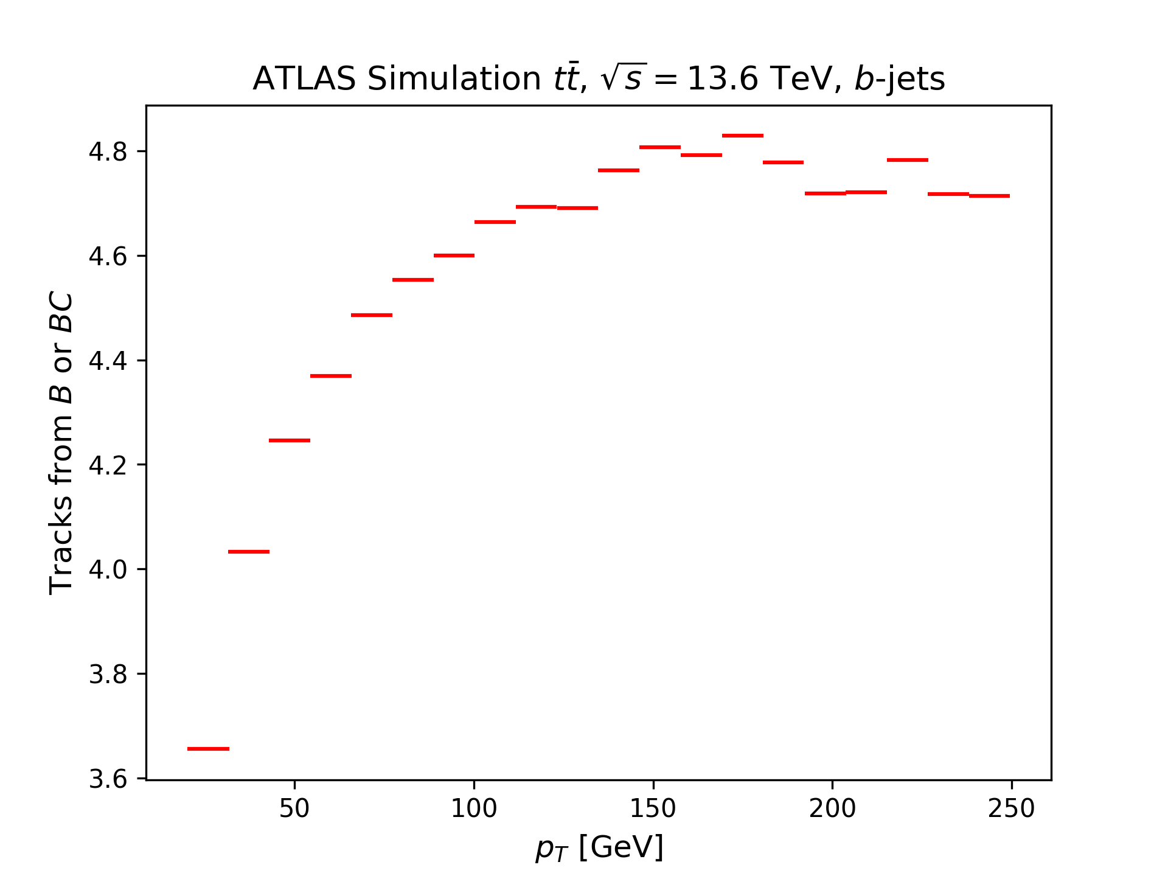
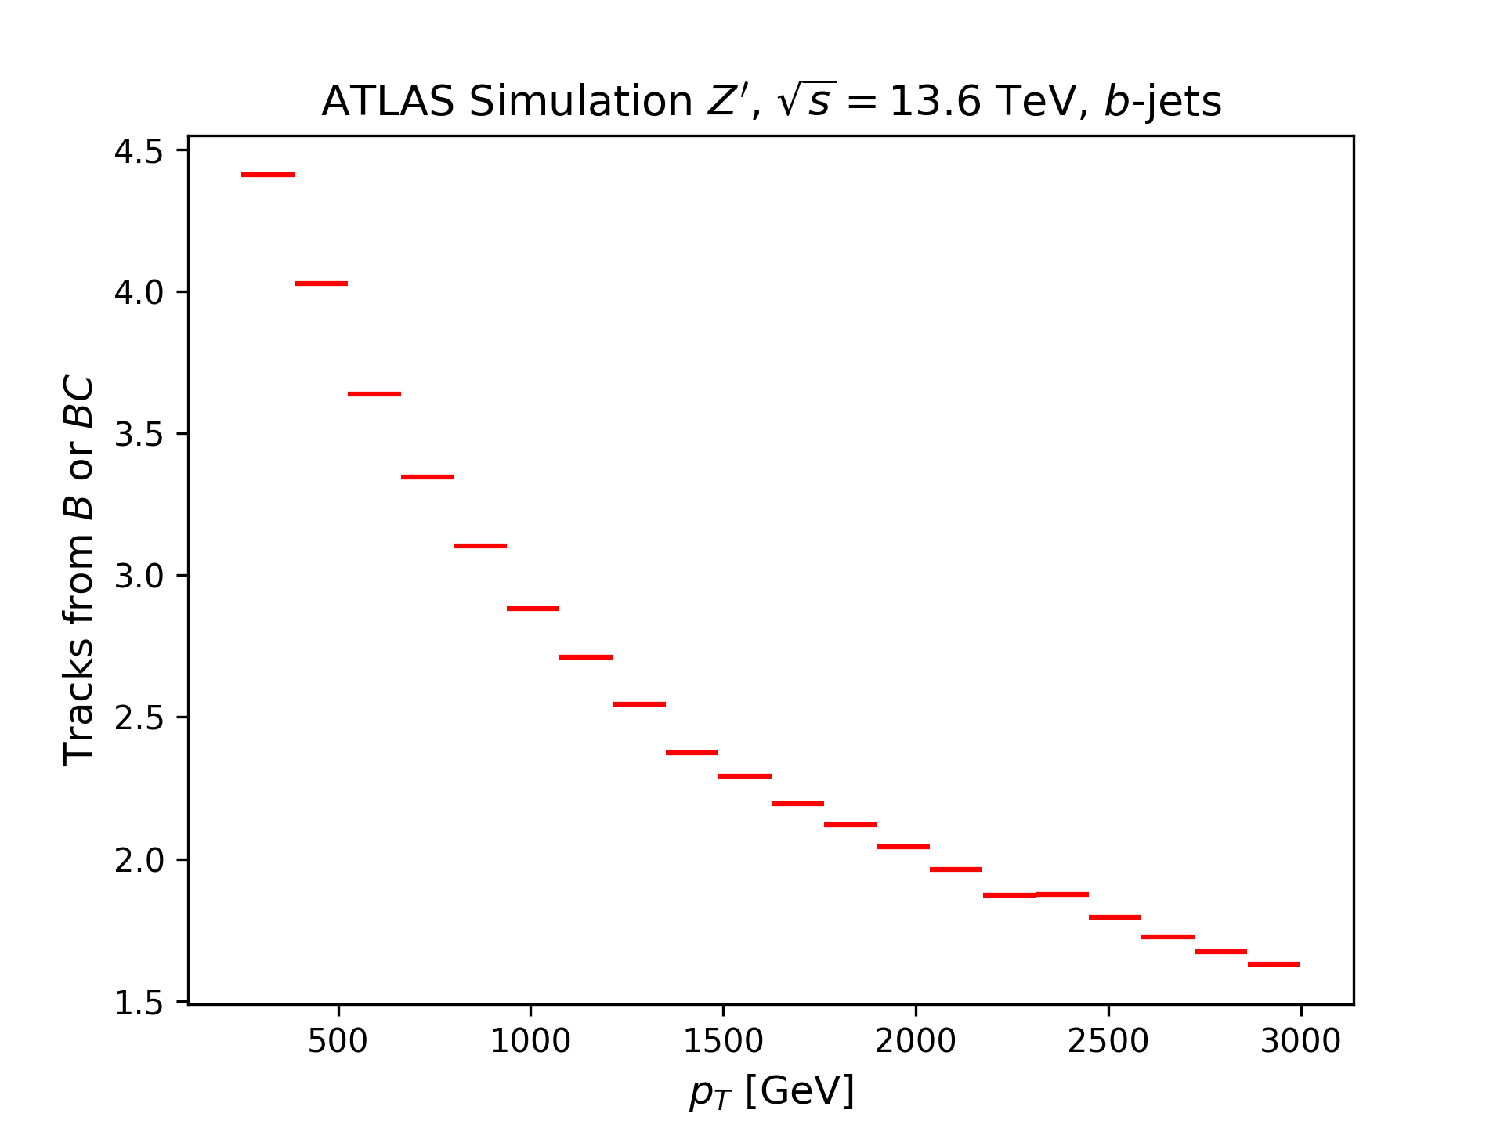

Number of tracks from $B$ or $BC$: $p_{T}$-dependence ($b$-sample)
Sub-sample of $b$-jets: The number of tracks from $B$ or $BC$ behave in the same way as the model performance: Low for small and high $p_{T}$, largest in $60<p_{T}<500 GeV$.

Slide 4
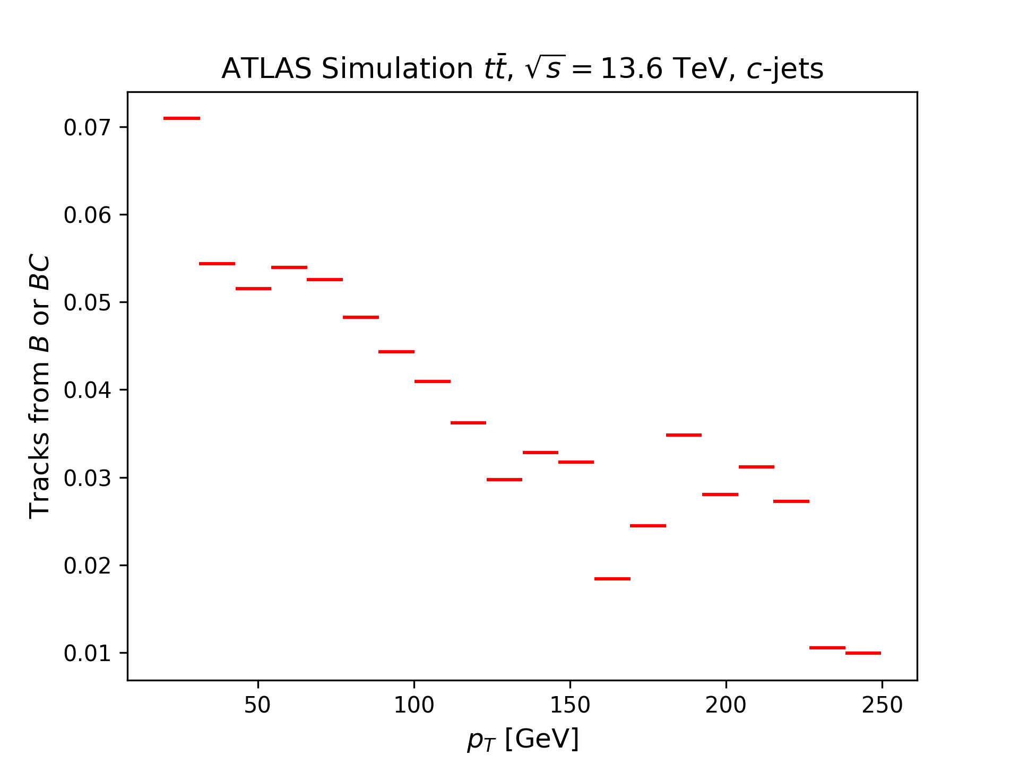
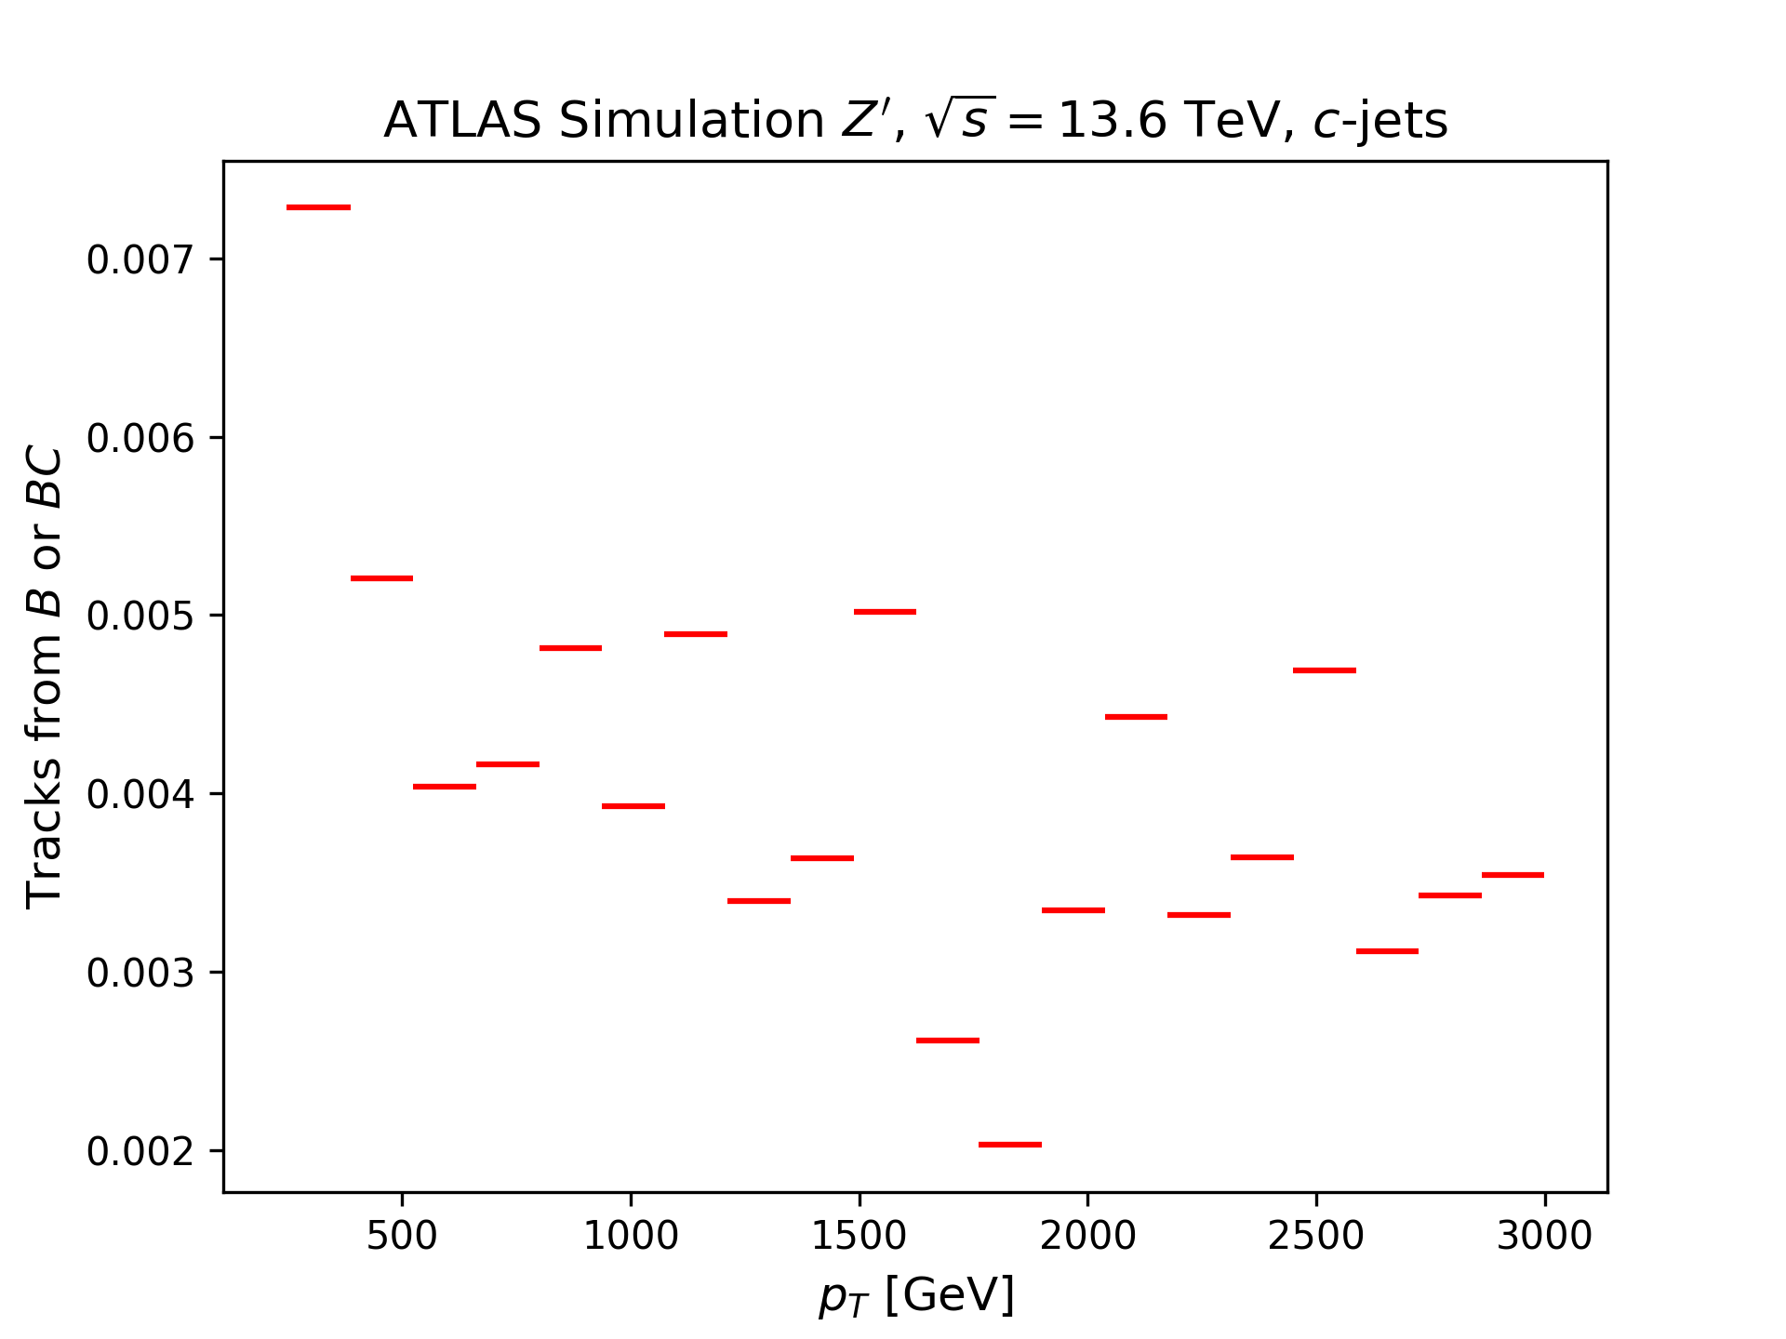

Number of tracks from $B$ or $BC$: $p_{T}$-dependence ($c$-sample)
Question: “Why are these bins not all 0, since $c$-jets should not contain any $B$-hadrons?“
Nikita: “You can have $b$- and $c$-jets near each other, so that the $B$-hadron intersect with the c-cone. When assigning the flavour, however, we look at a tighter cone of $ΔR=0.3$.“

Slide 5
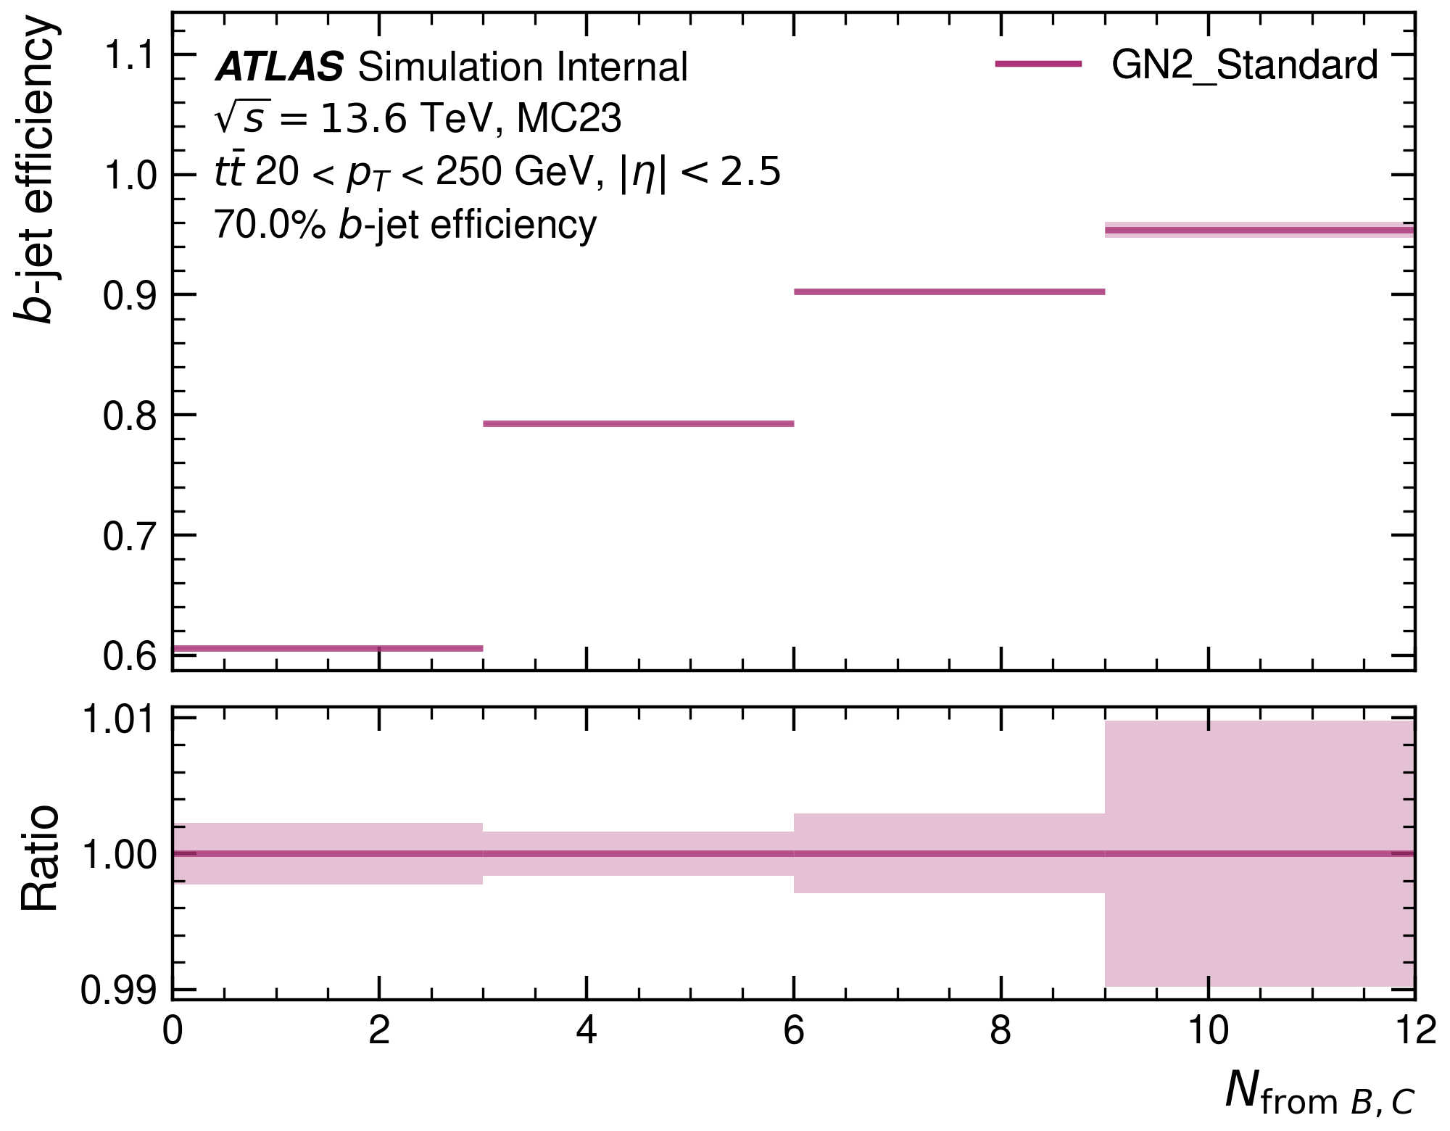
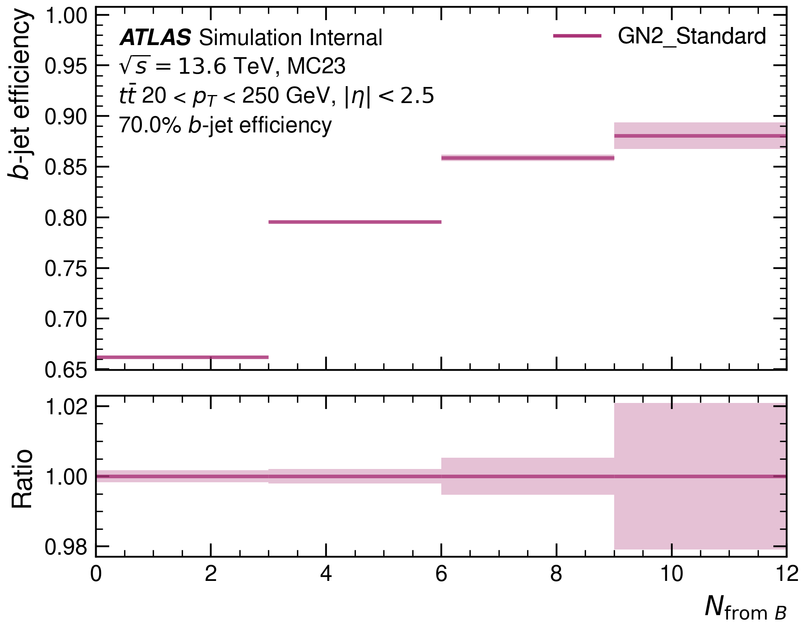
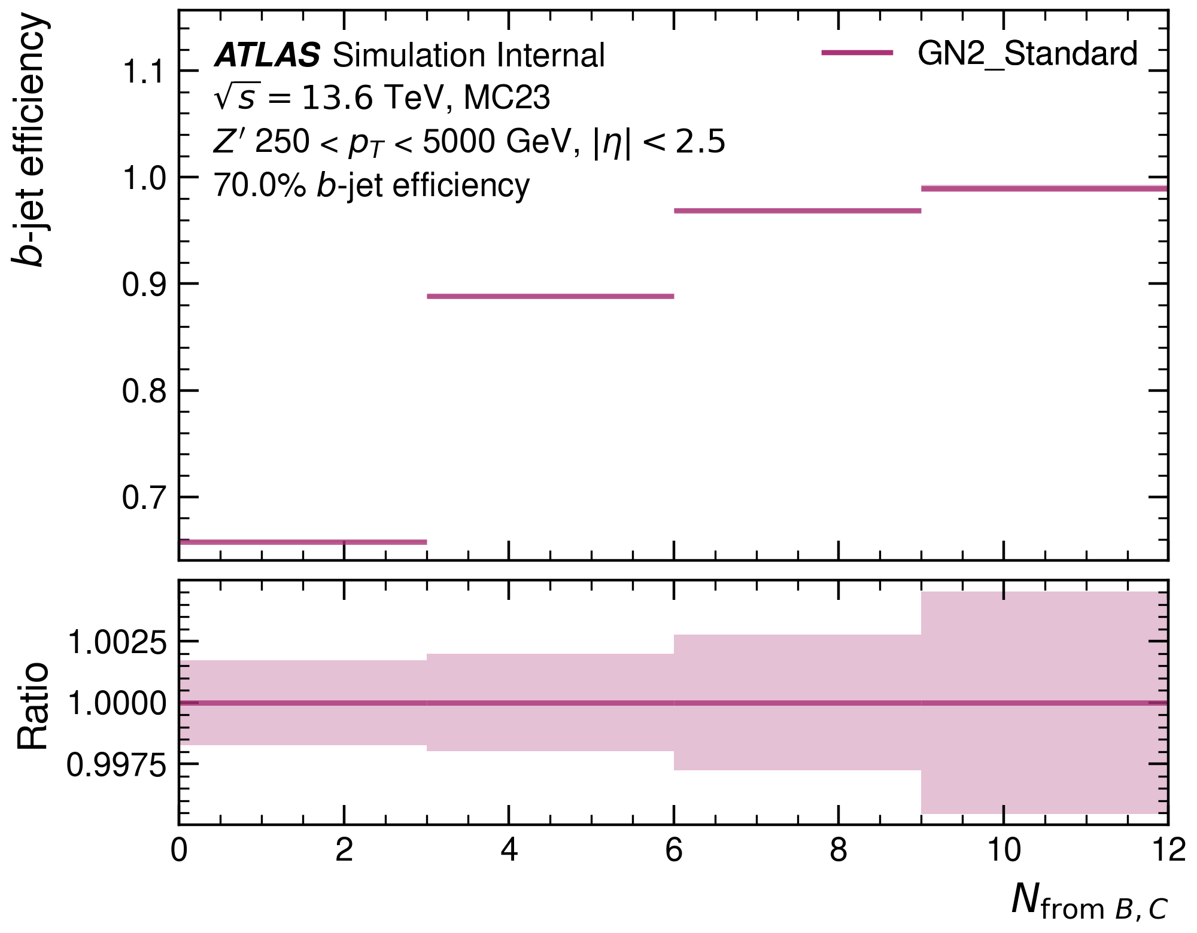
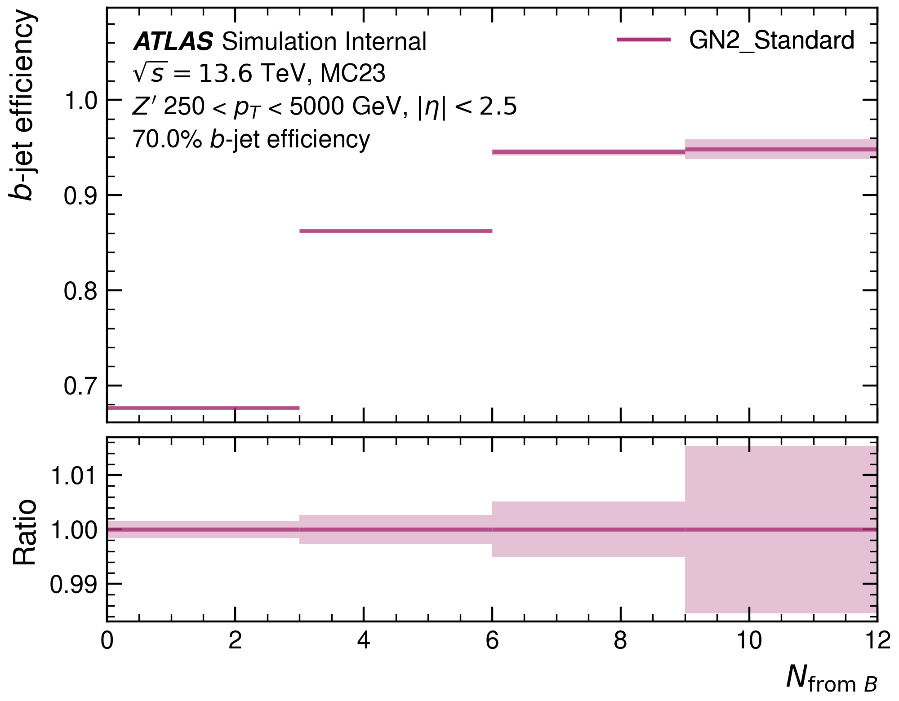
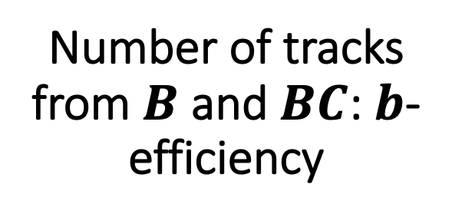
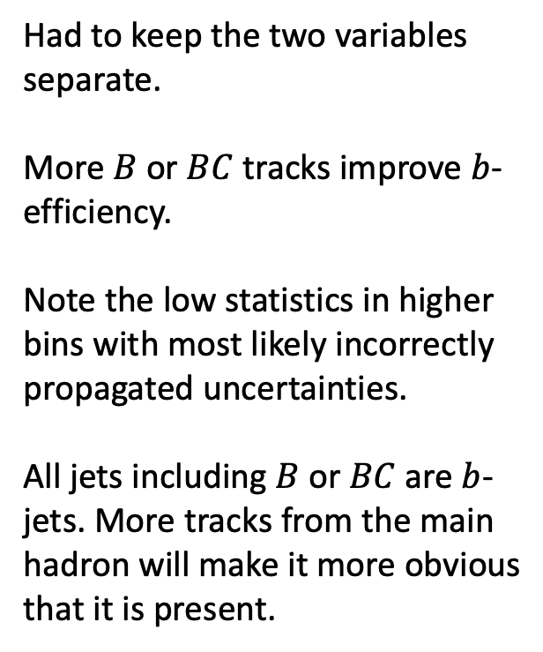
Number of tracks from $B$ and $BC$: $b$-efficiency
Had to keep the two variables separate.
More $B$ or $BC$ tracks improve $b$-efficiency.
Note the low statistics in higher bins with most likely incorrectly propagated uncertainties.
All jets including $B$ or $BC$ are $b$-jets. More tracks from the main hadron will make it more obvious that it is present.

Slide 6
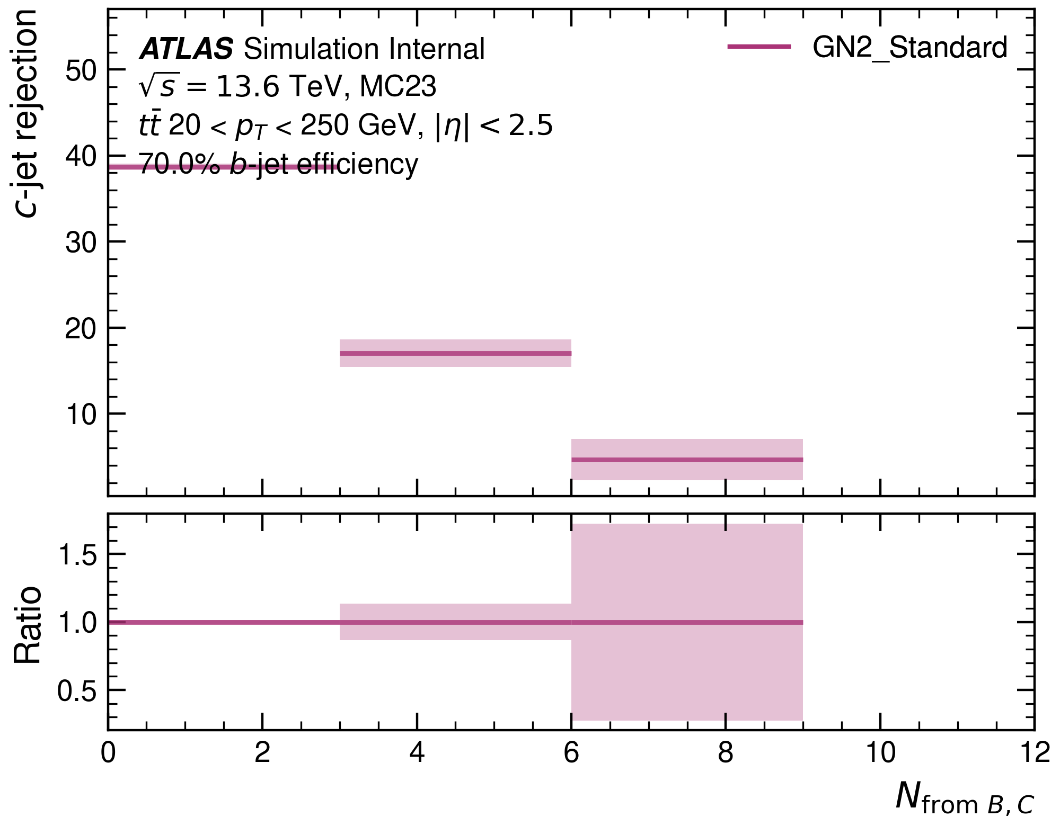
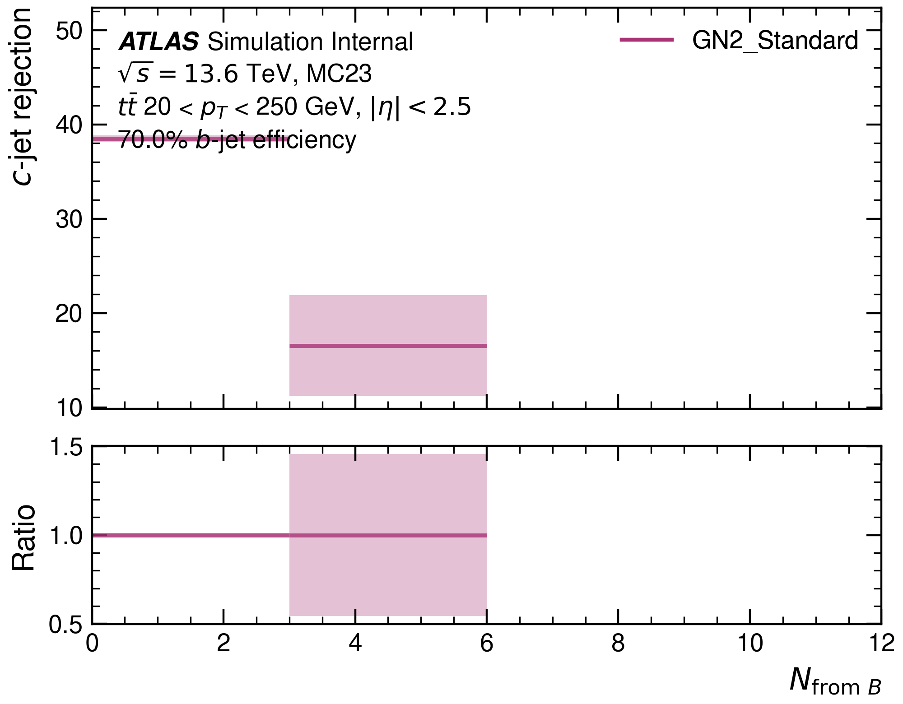
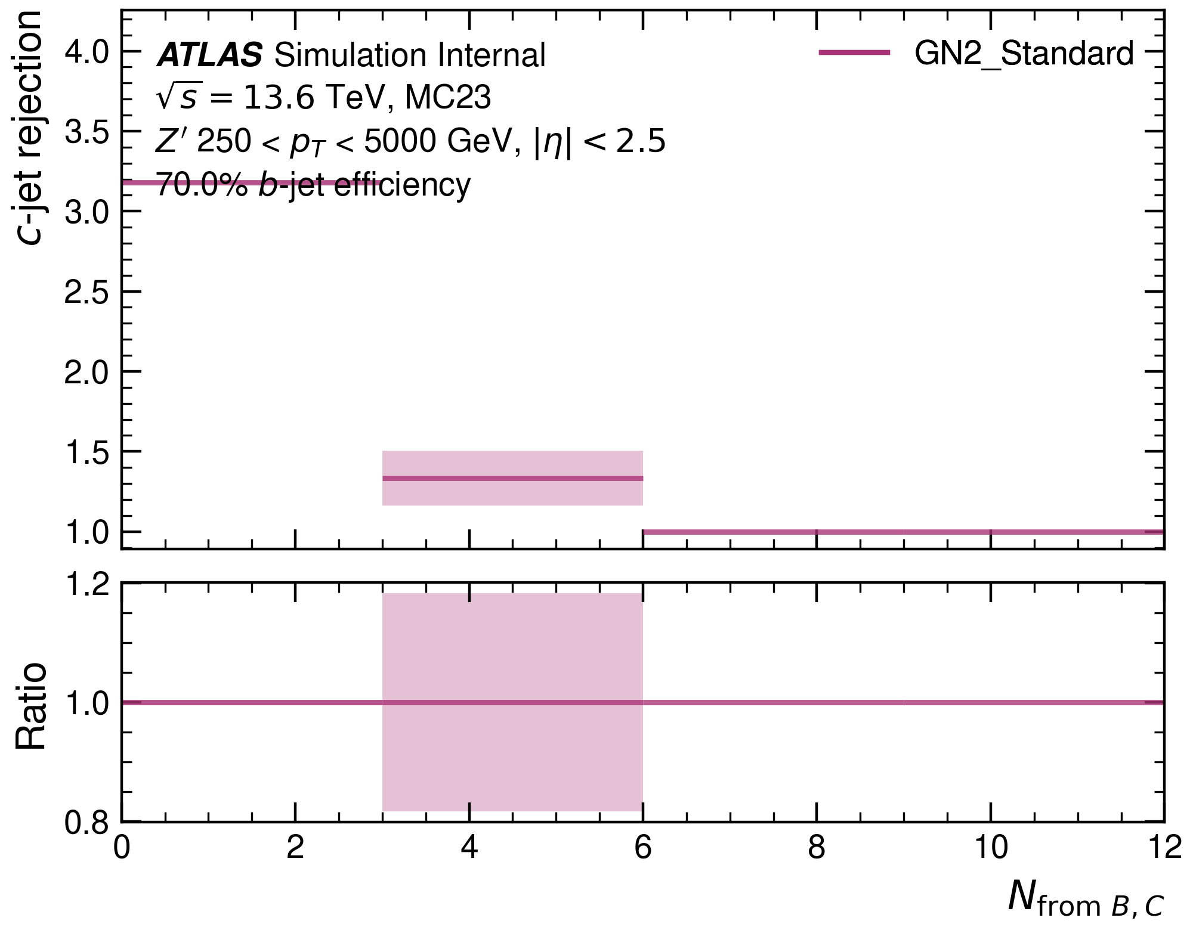
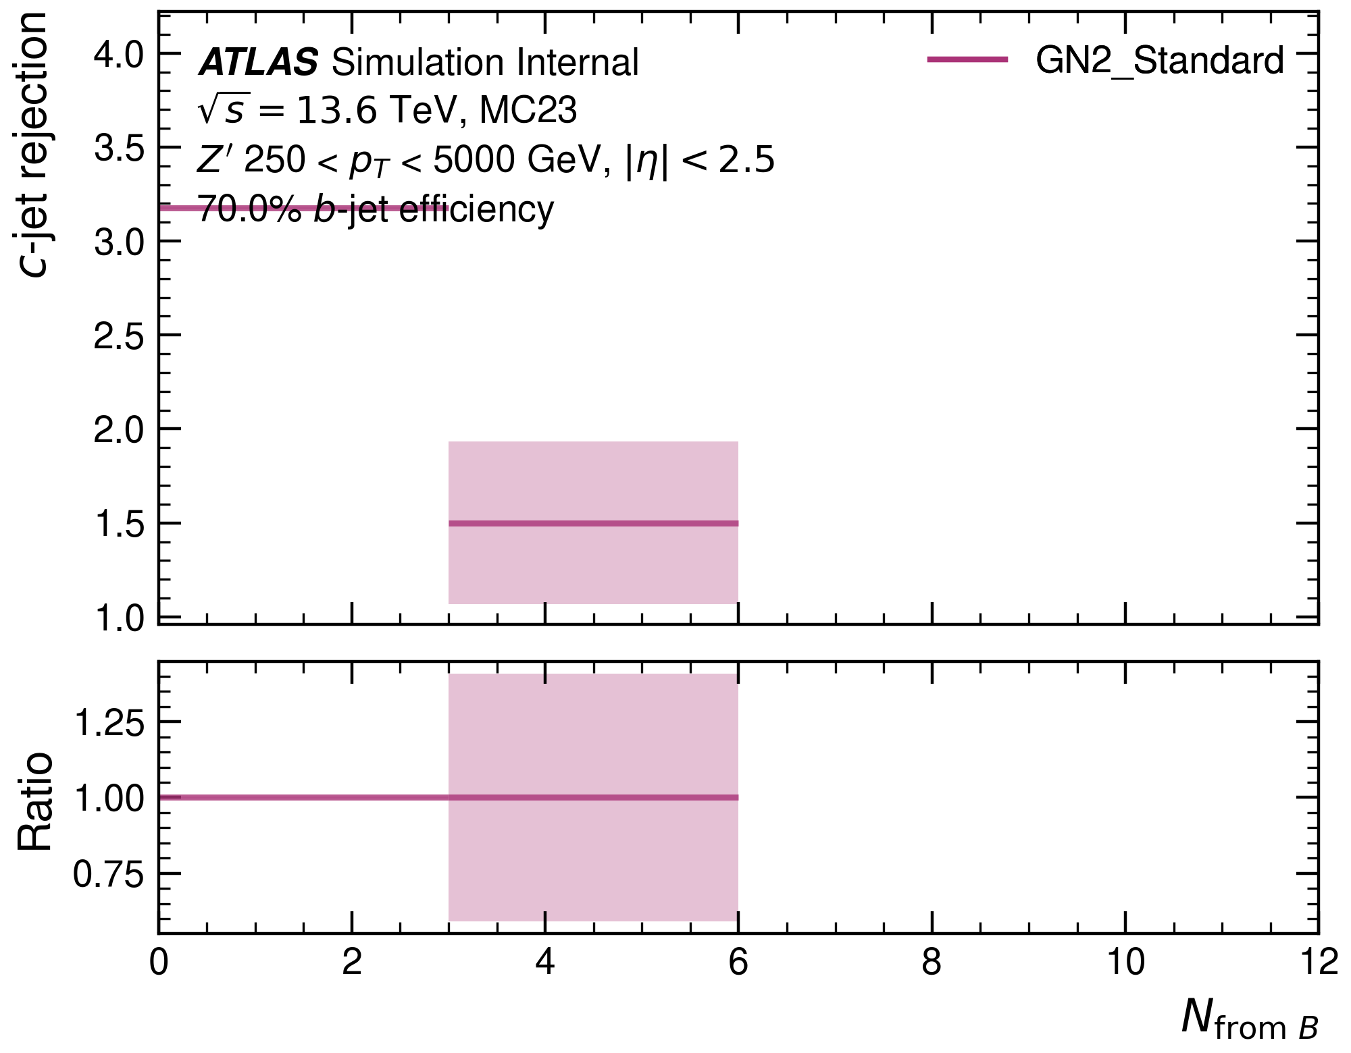


Number of tracks from $B$ and $BC$: $c$-rejection
The number of tracks from $B$/$BC$ is a defining variable of $b$-jets.
Backround rejection decreases in bins with a large number of $B$/$BC$-tracks.
These bins do not have much background anyways, and if they do it will look very similar to the signal.

Slide 7
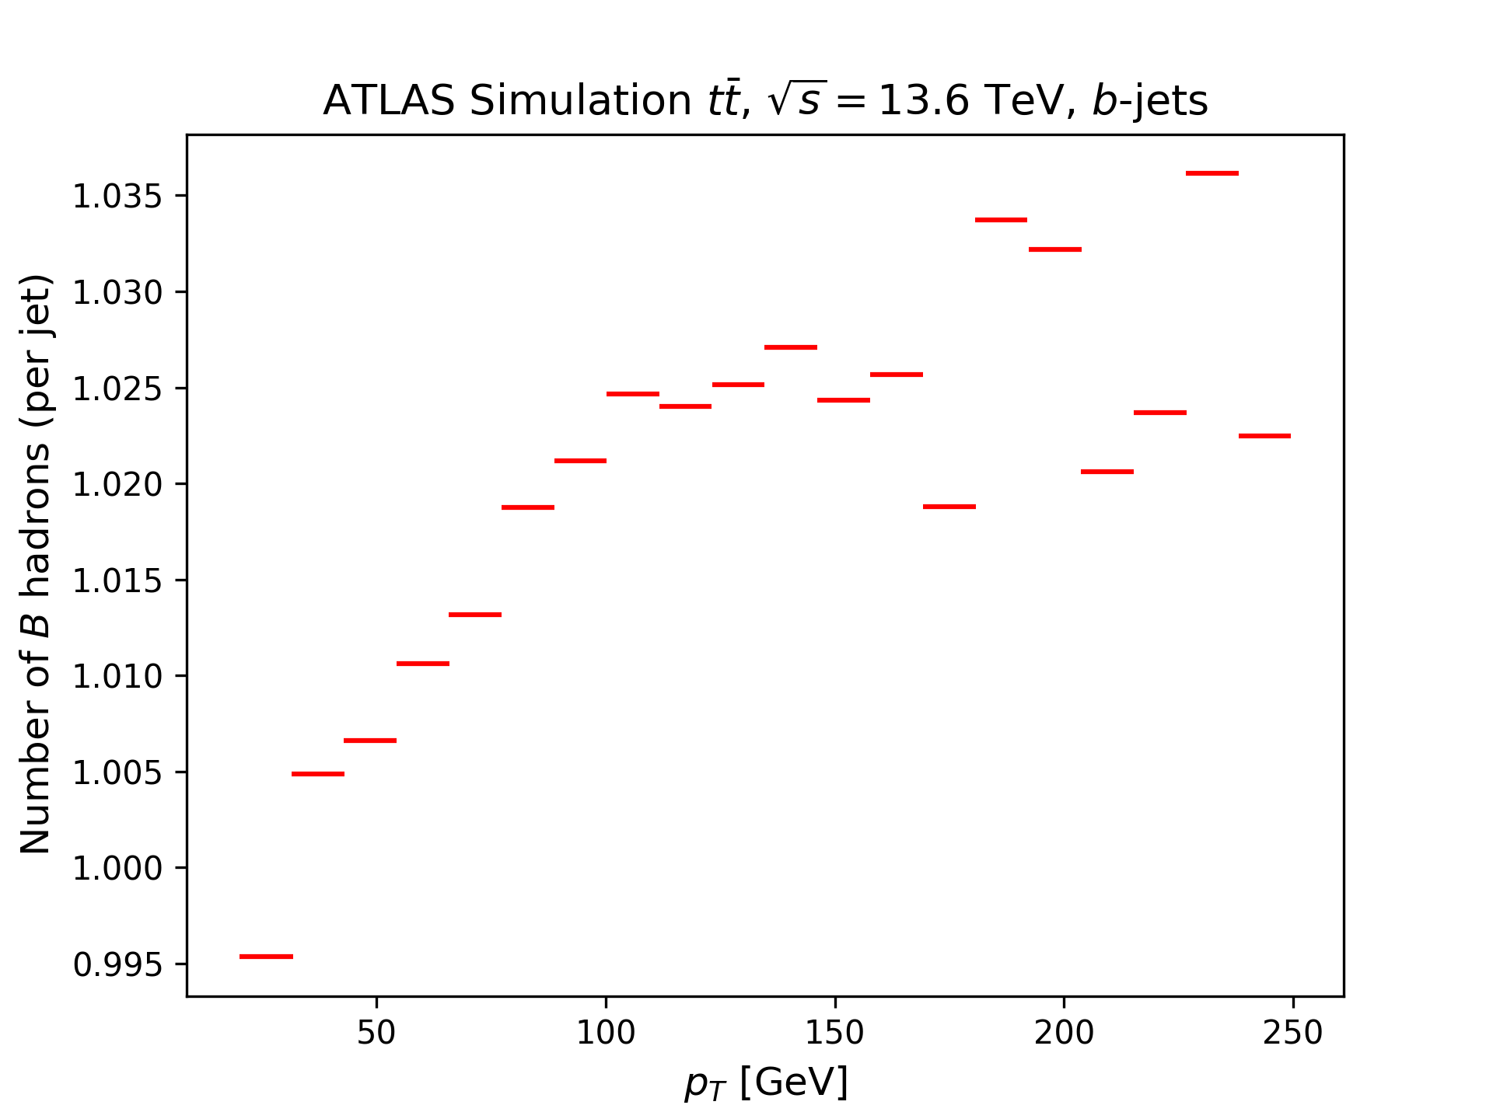
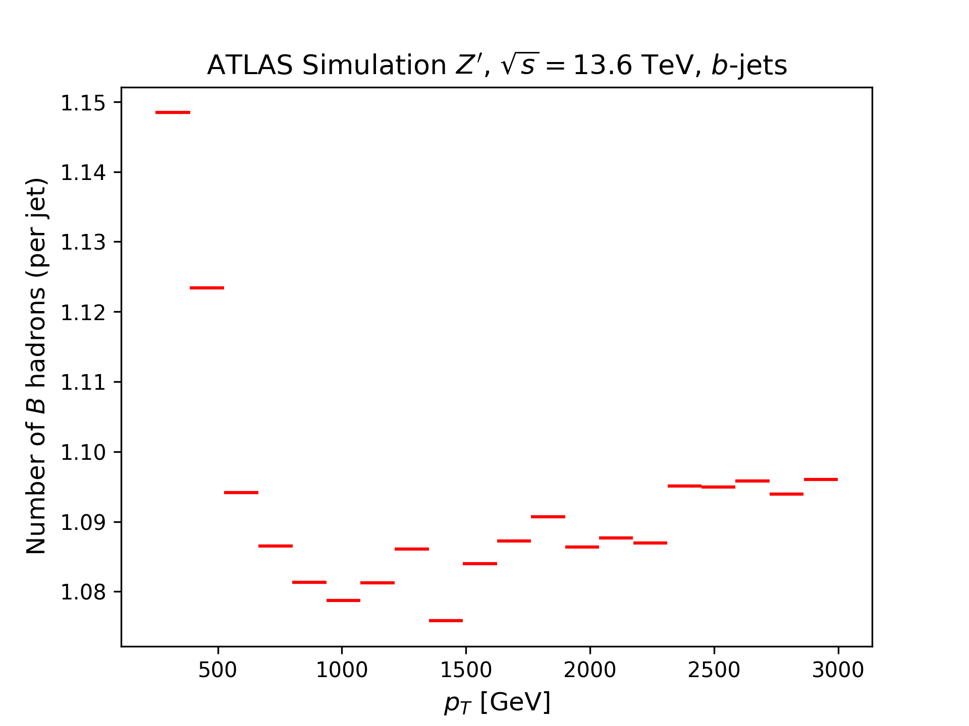
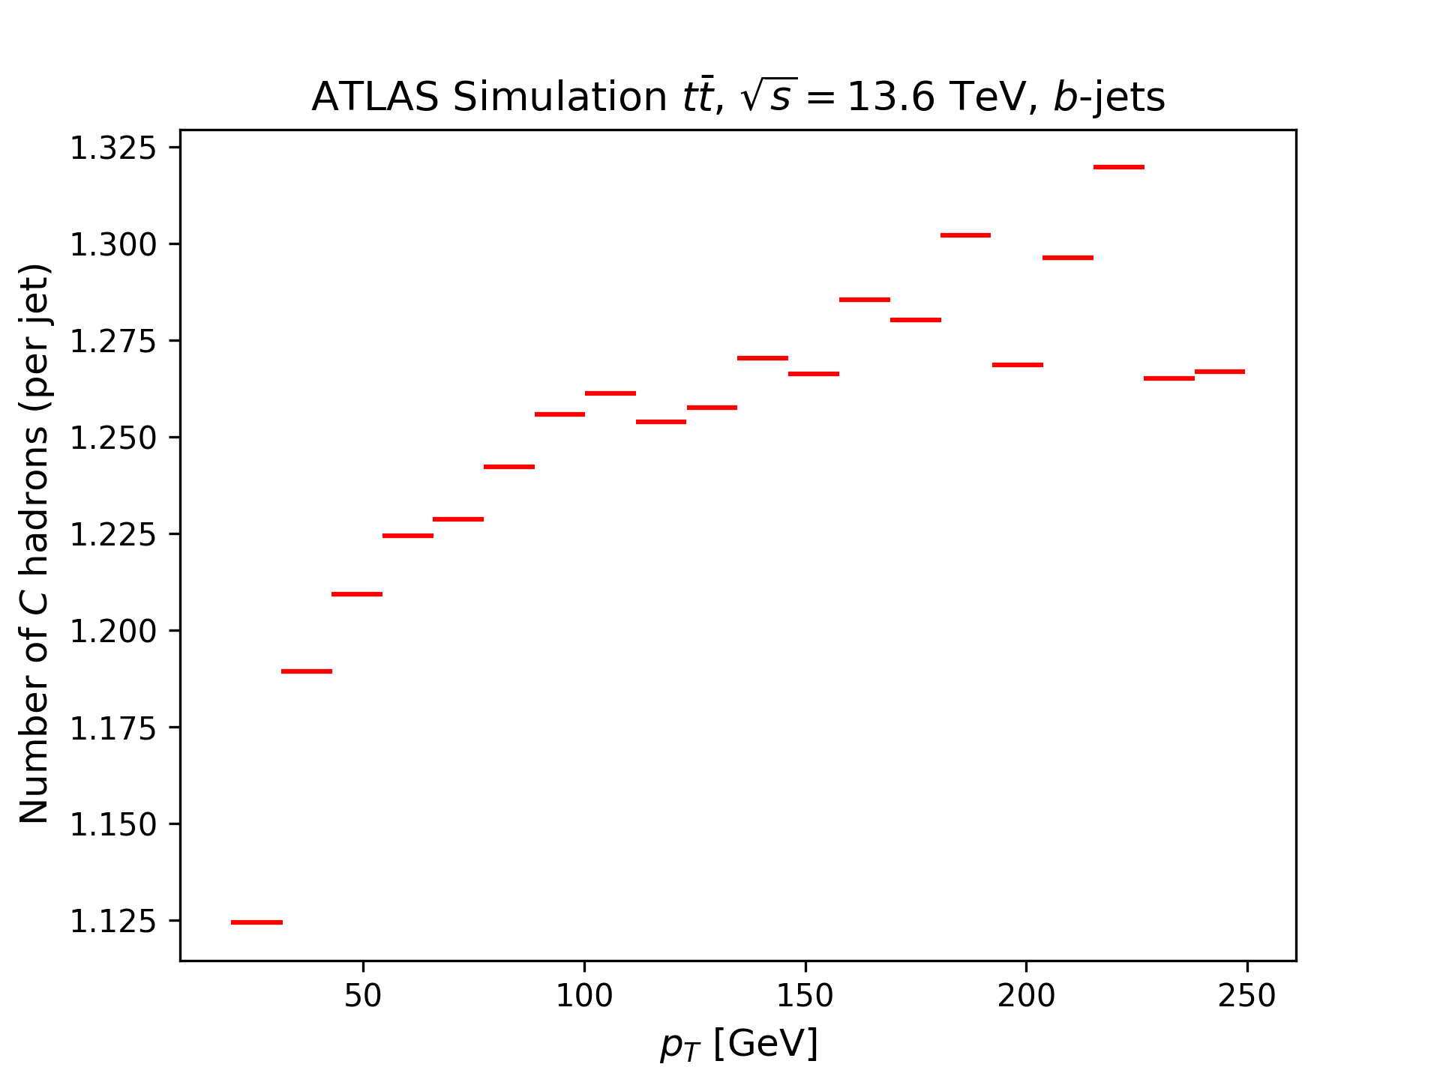
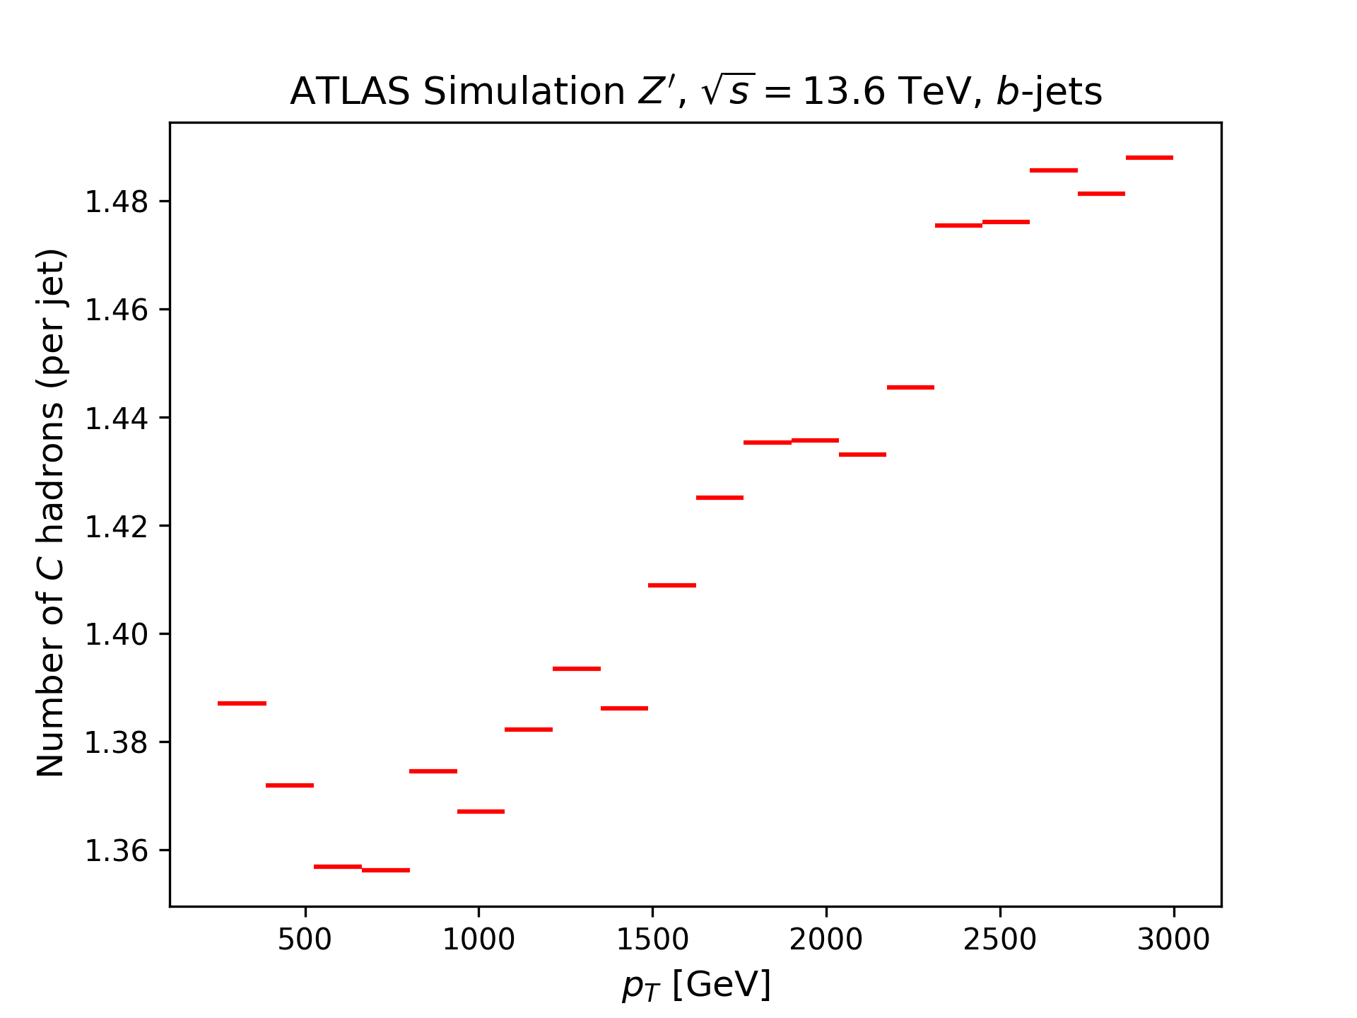
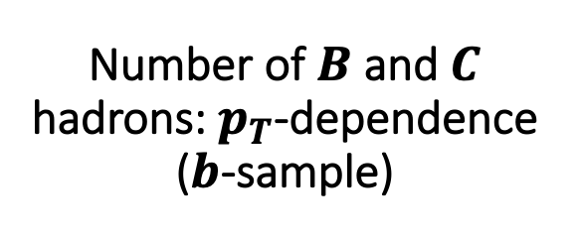
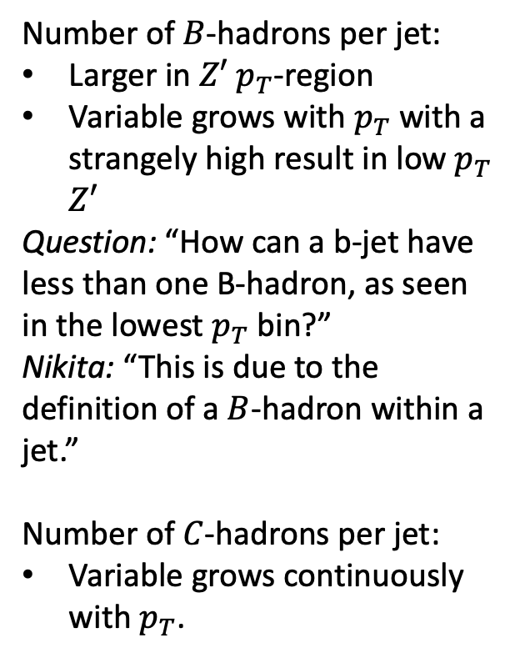
Number of $B$ and $C$ hadrons: $p_{T}$-dependence ($b$-sample)
Number of $B$-hadrons per jet:
Larger in $Z′$ $p_{T}$-region
Variable grows with $p_{T}$ with a strangely high result in low $p_{T}$ $Z′$
Question: “How can a b-jet have less than one B-hadron, as seen in the lowest $p_{T}$ bin?”
Nikita: “This is due to the definition of a $B$-hadron within a jet.”
Number of $C$-hadrons per jet:
Variable grows continuously with $p_{T}$.

Slide 8
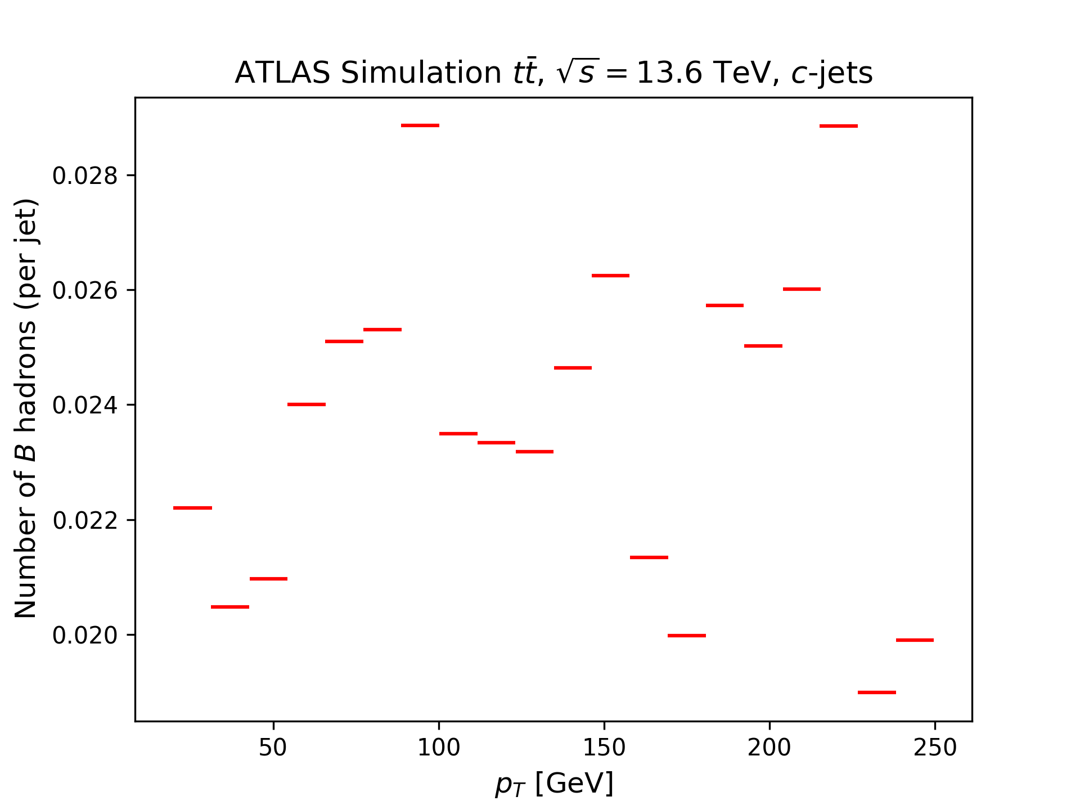
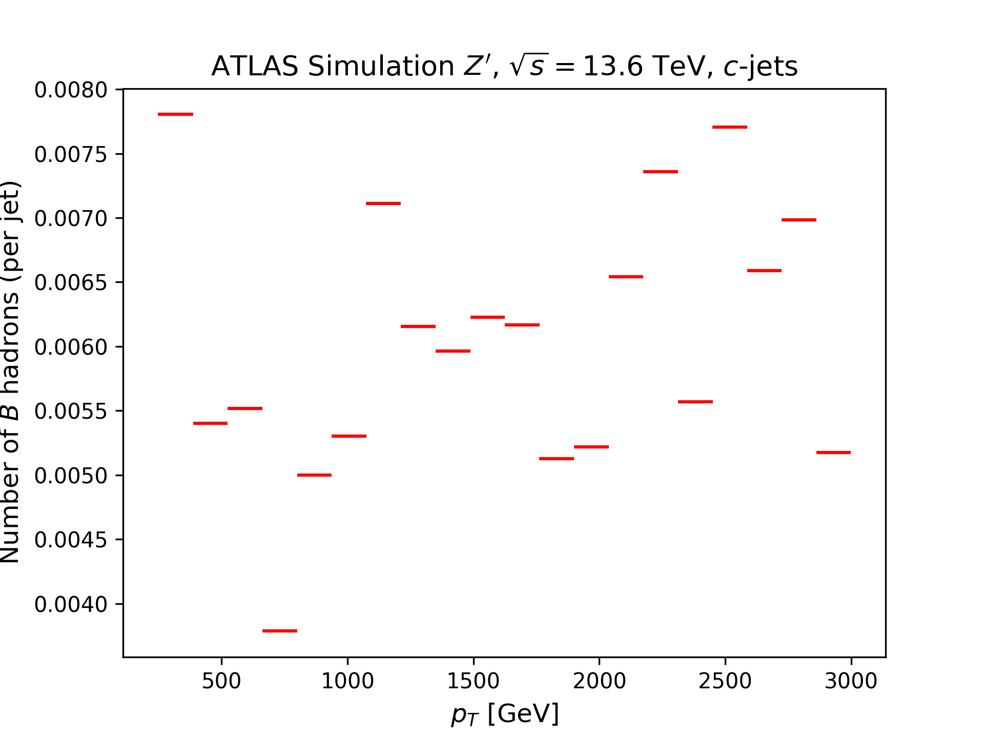
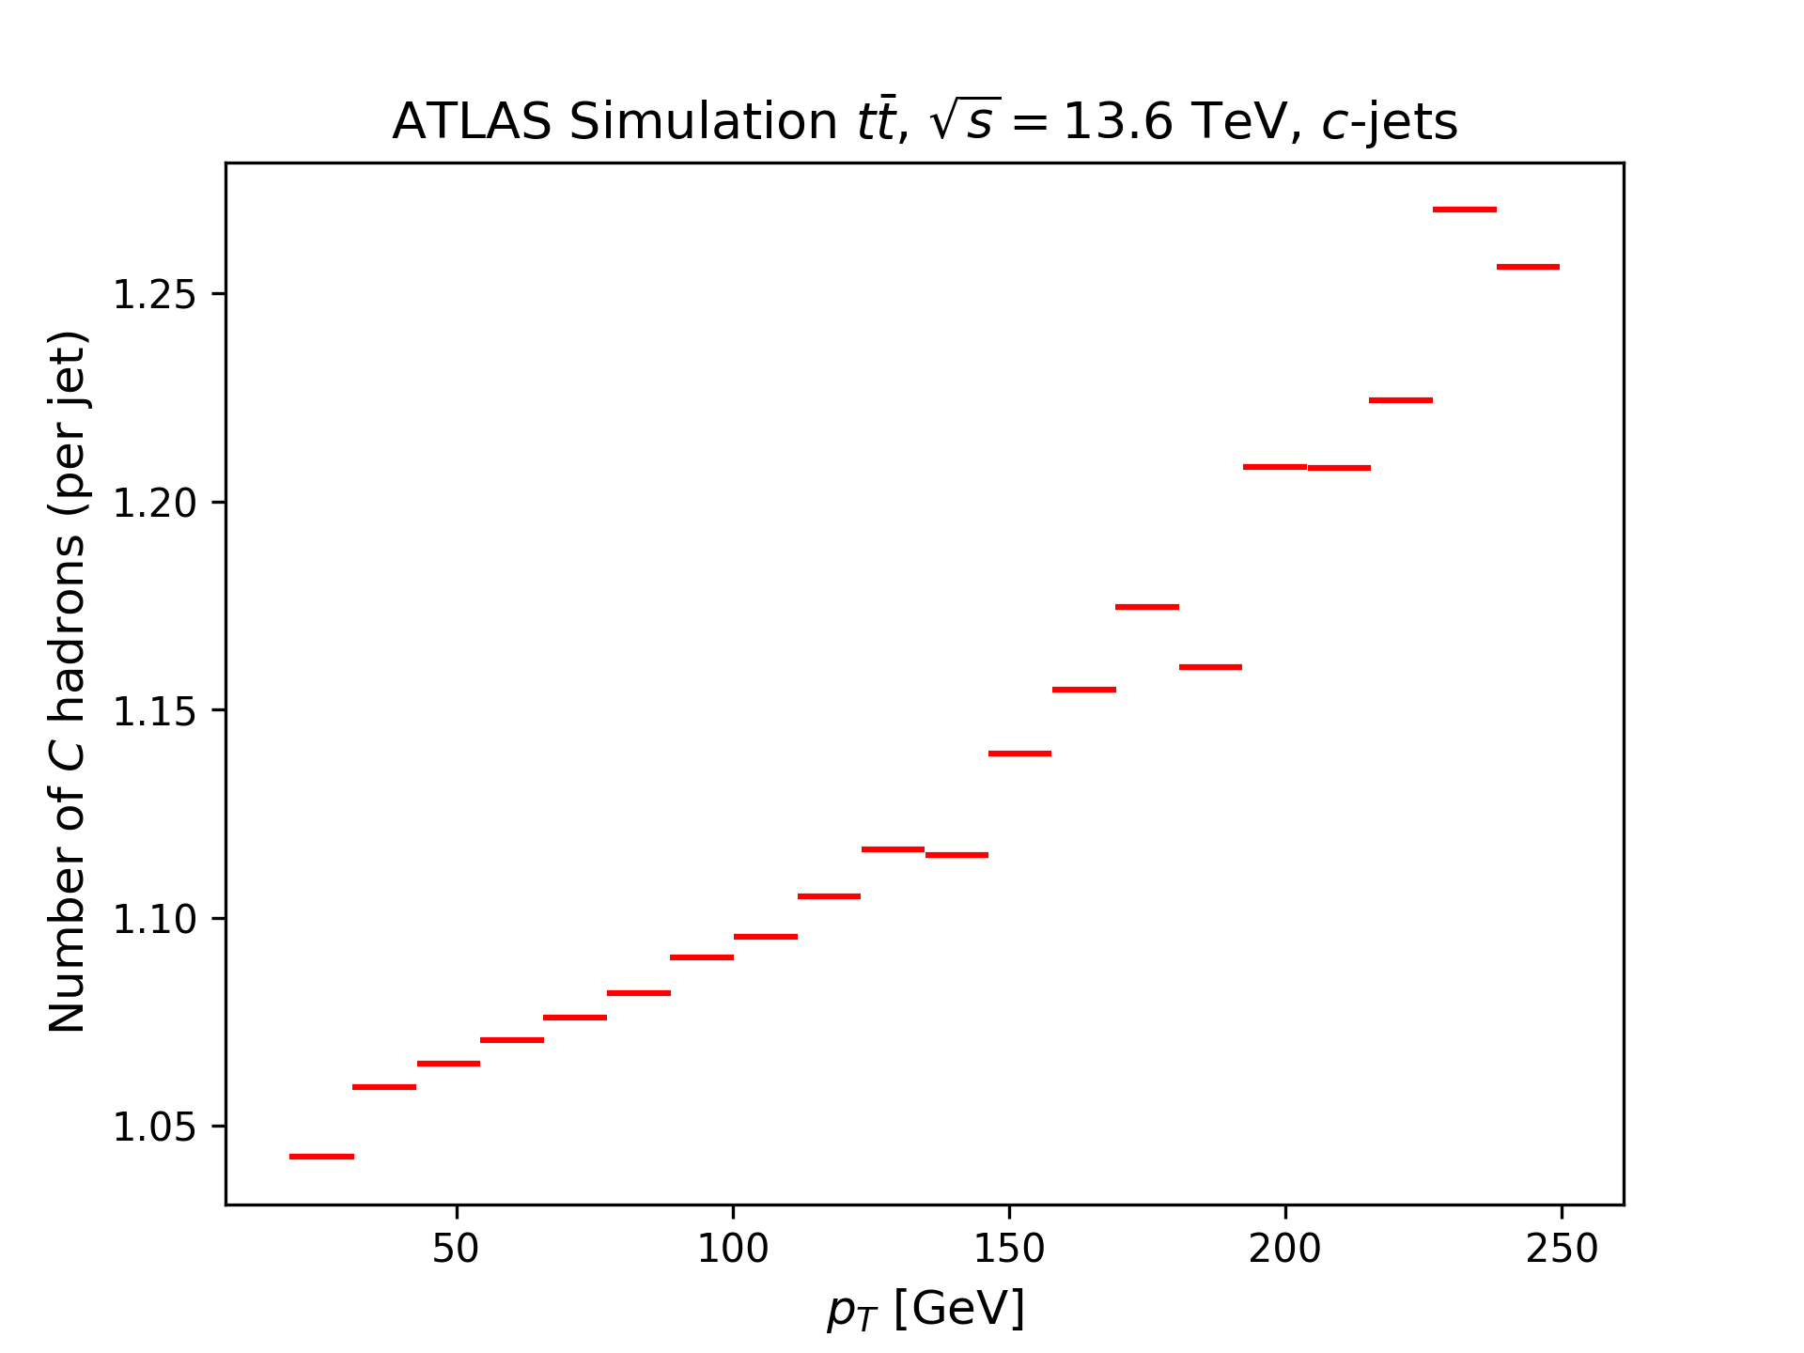
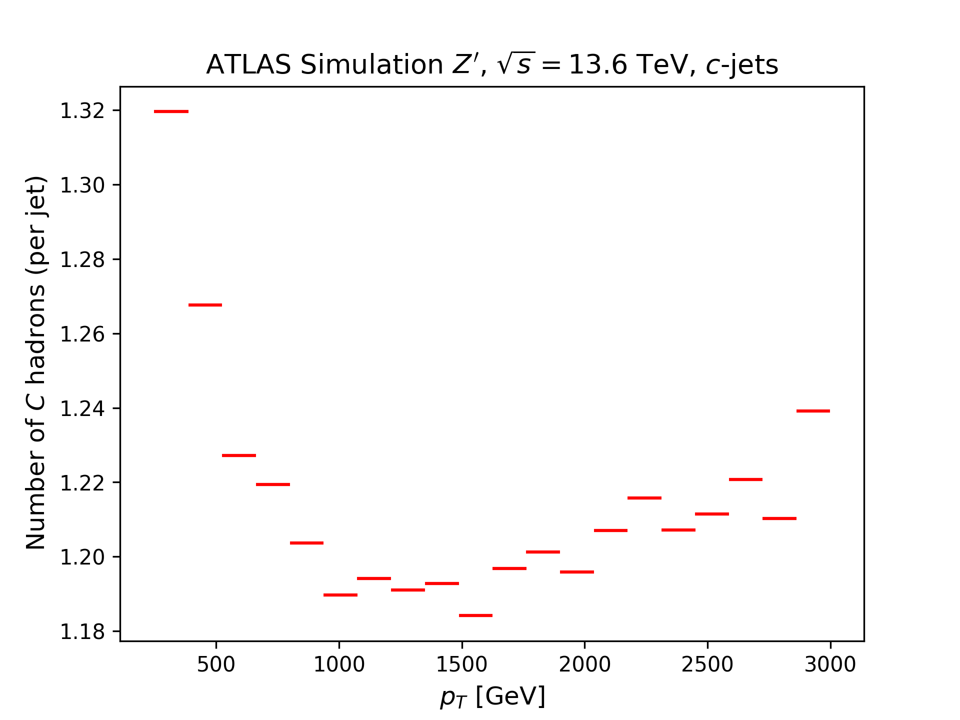
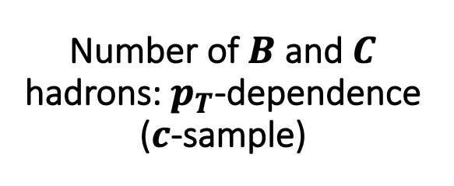
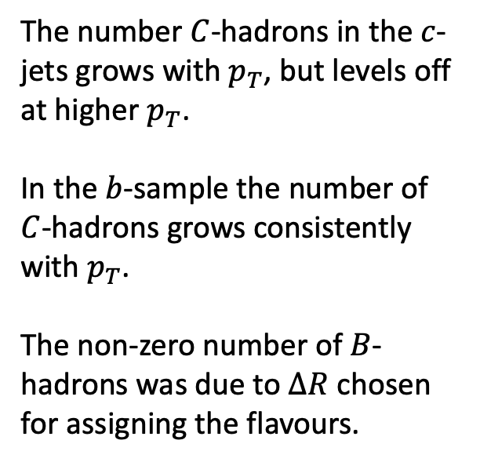
Number of $B$ and $C$ hadrons: $p_{T}$-dependence ($c$-sample)
The number $C$-hadrons in the $c$-jets grows with $p_{T}$, but levels off at higher $p_{T}$.
In the $b$-sample the number of $C$-hadrons grows consistently with $p_{T}$.
The non-zero number of $B$-hadrons was due to $ΔR$ chosen for assigning the flavours.

Slide 9
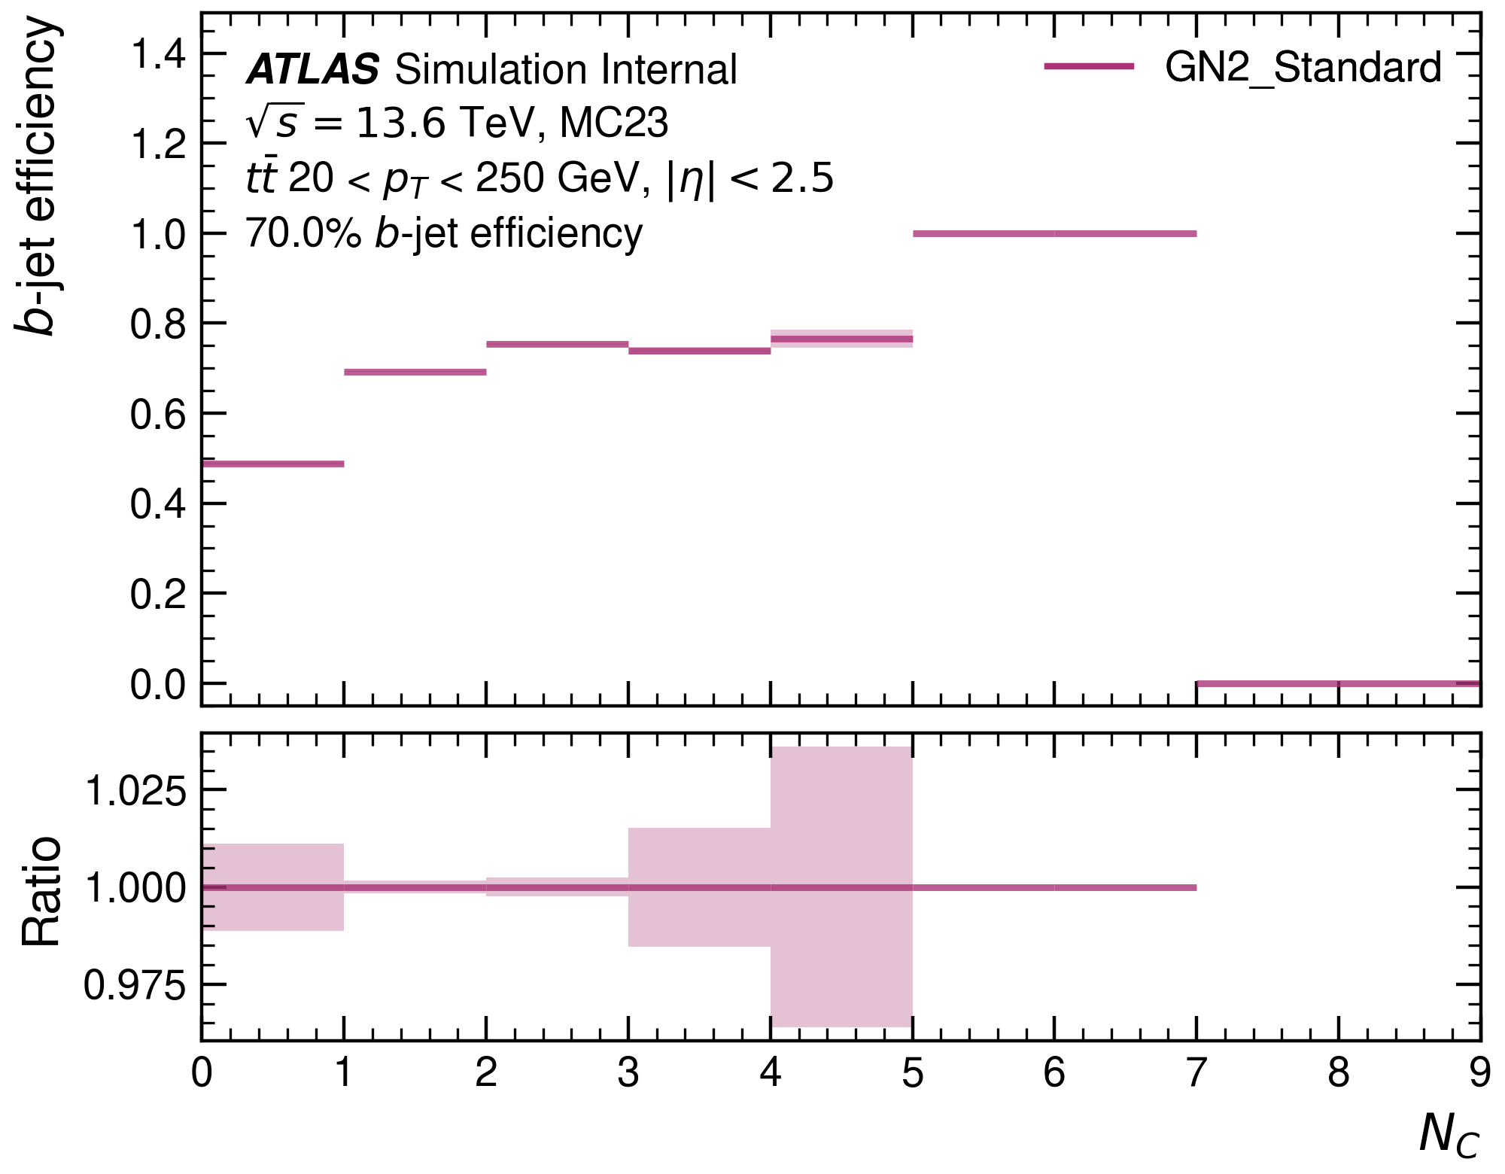
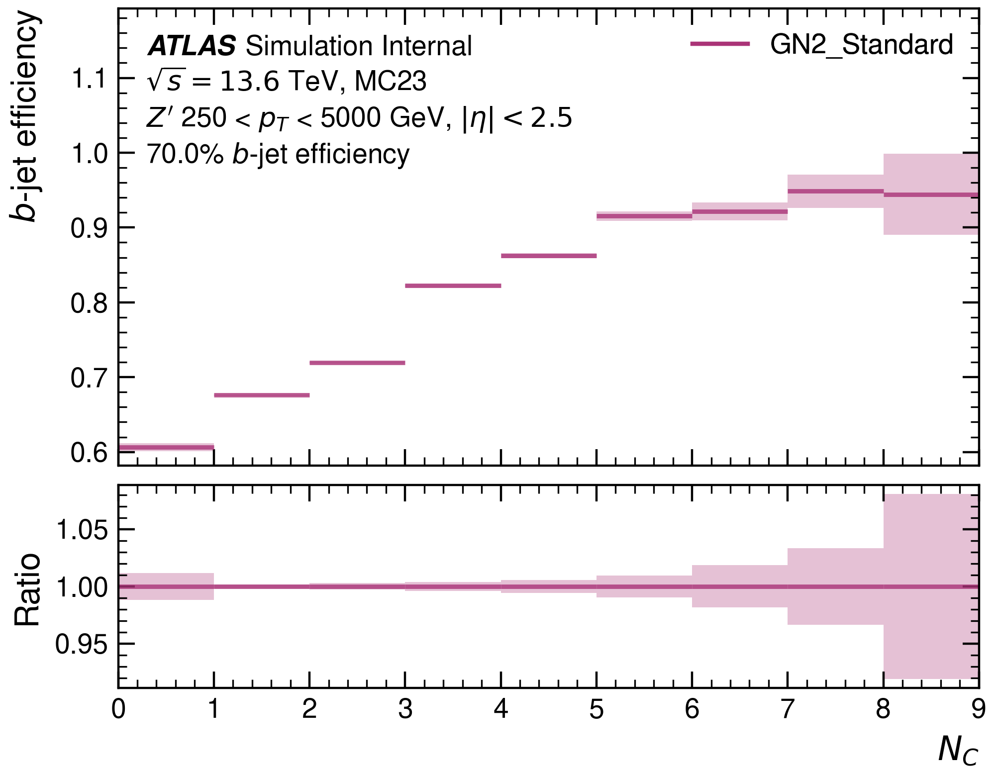
Number of $C$-hadrons: $b$-efficiency
The model performs well in bins with large number of $C$-hadrons.
In fact, it performs worse when no $C$-hadrons are in the jet.

Slide 10
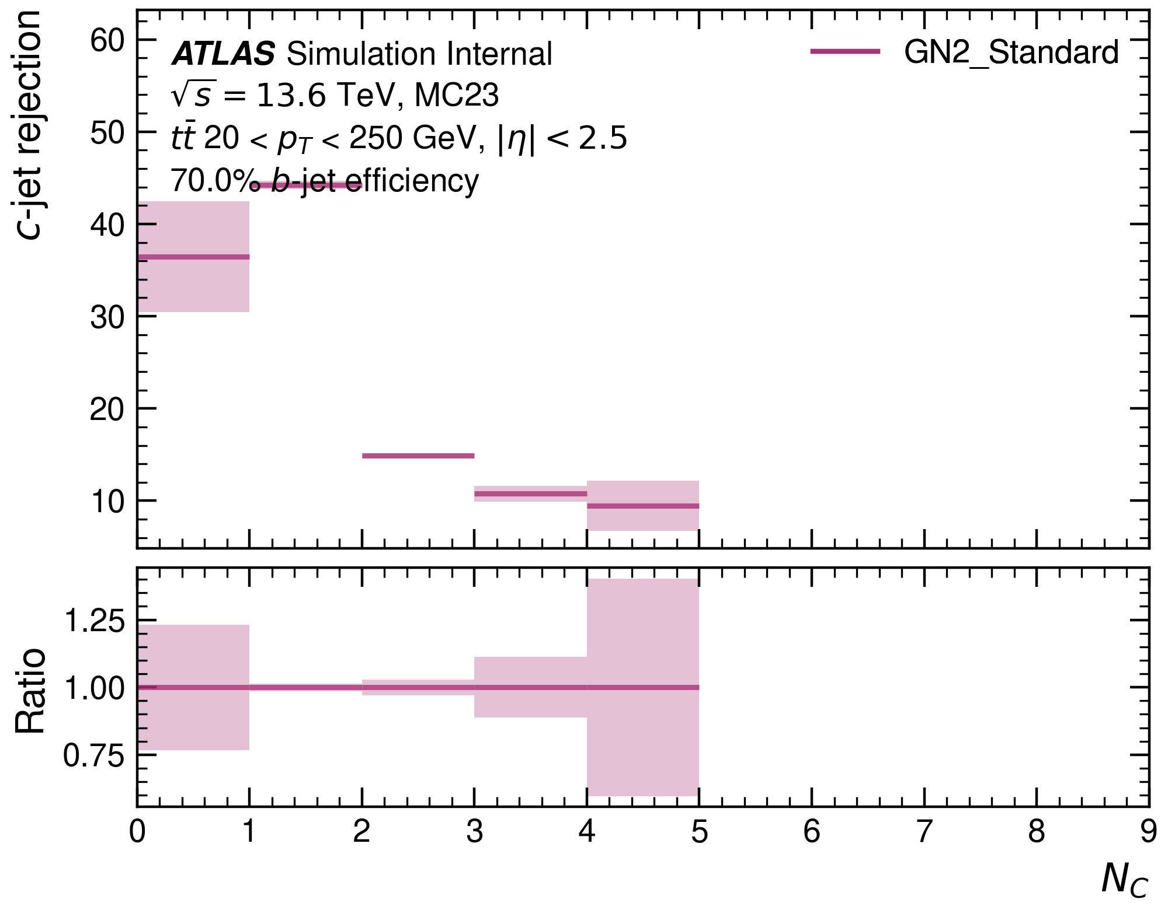
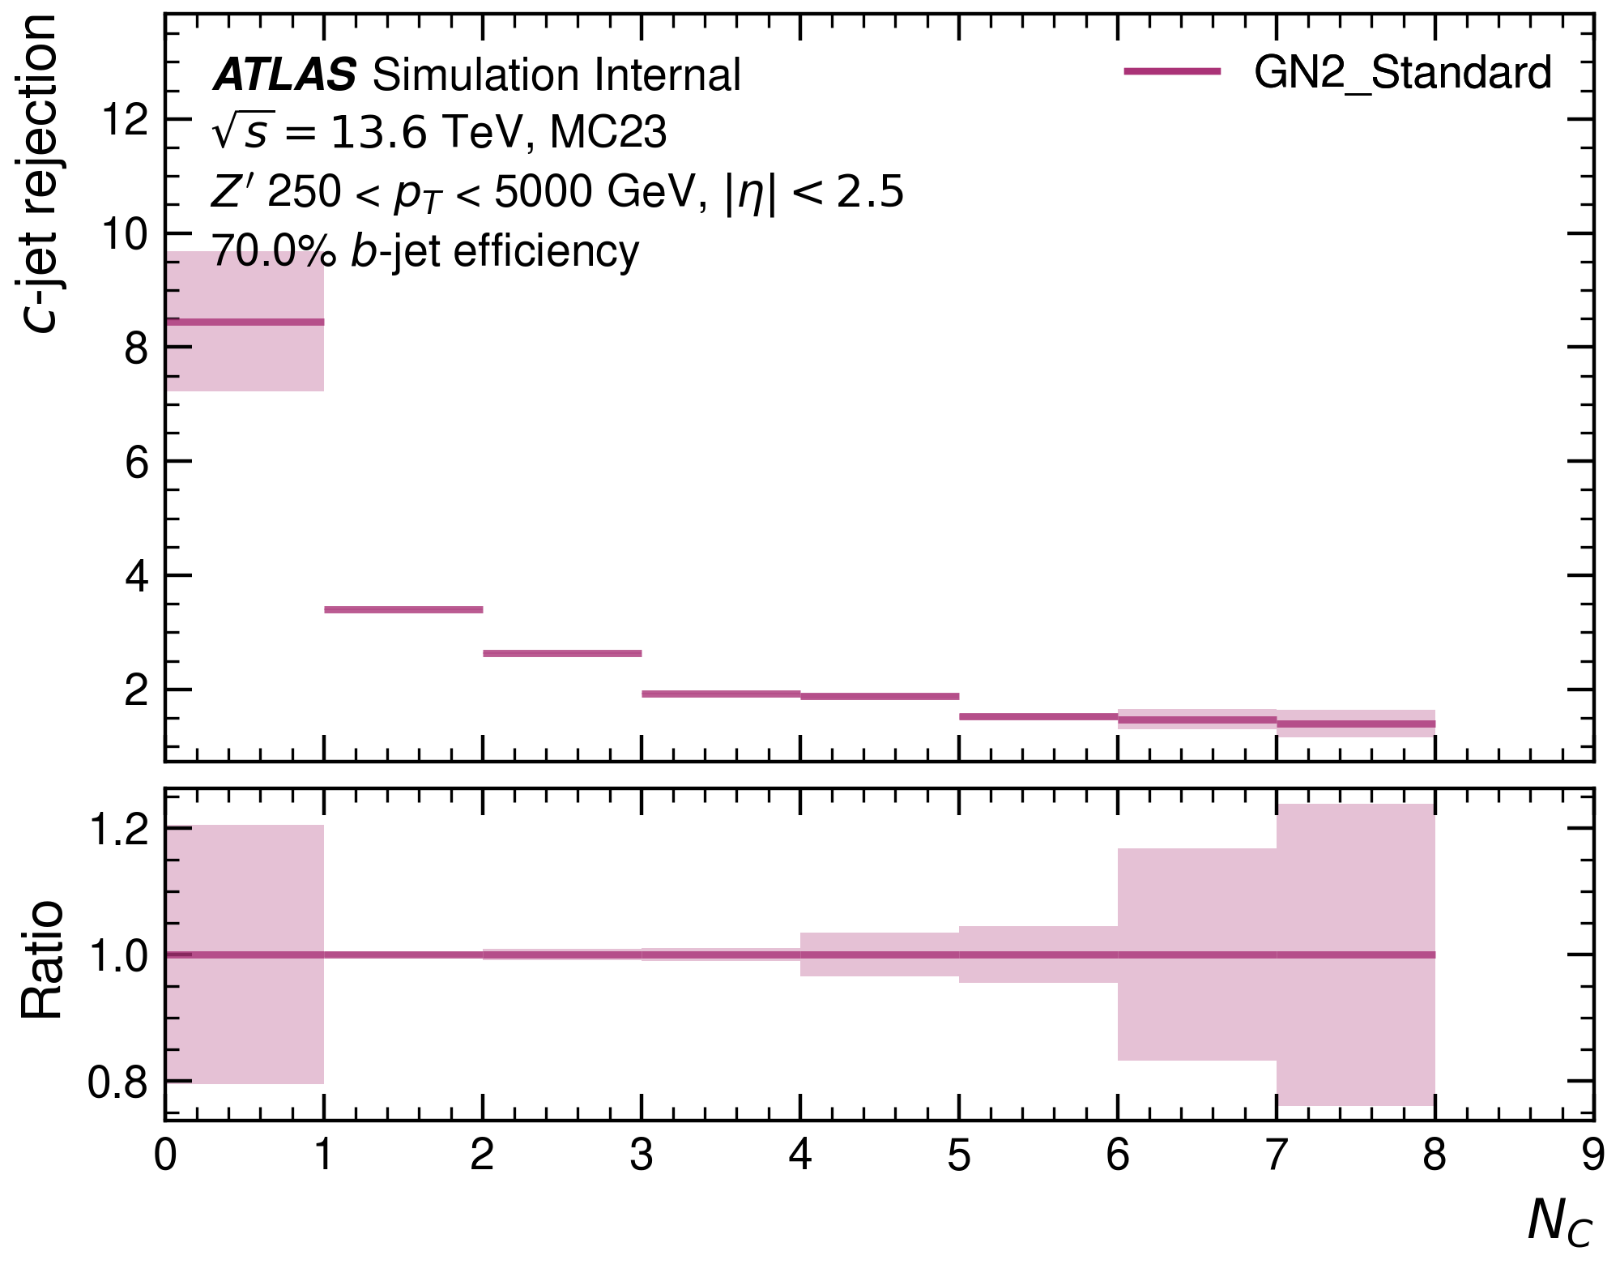
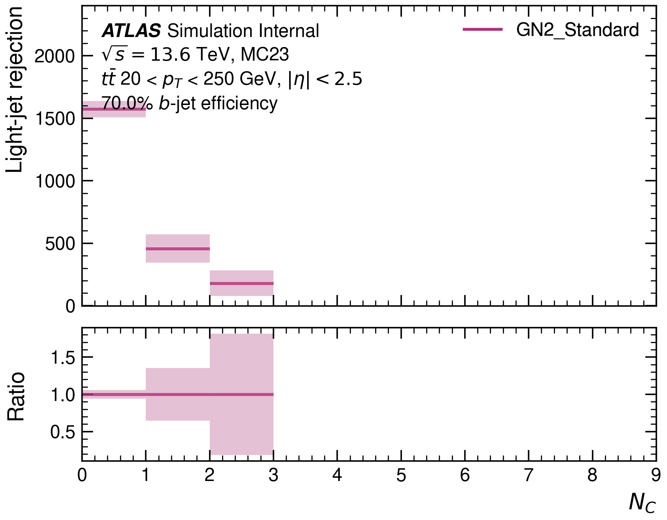
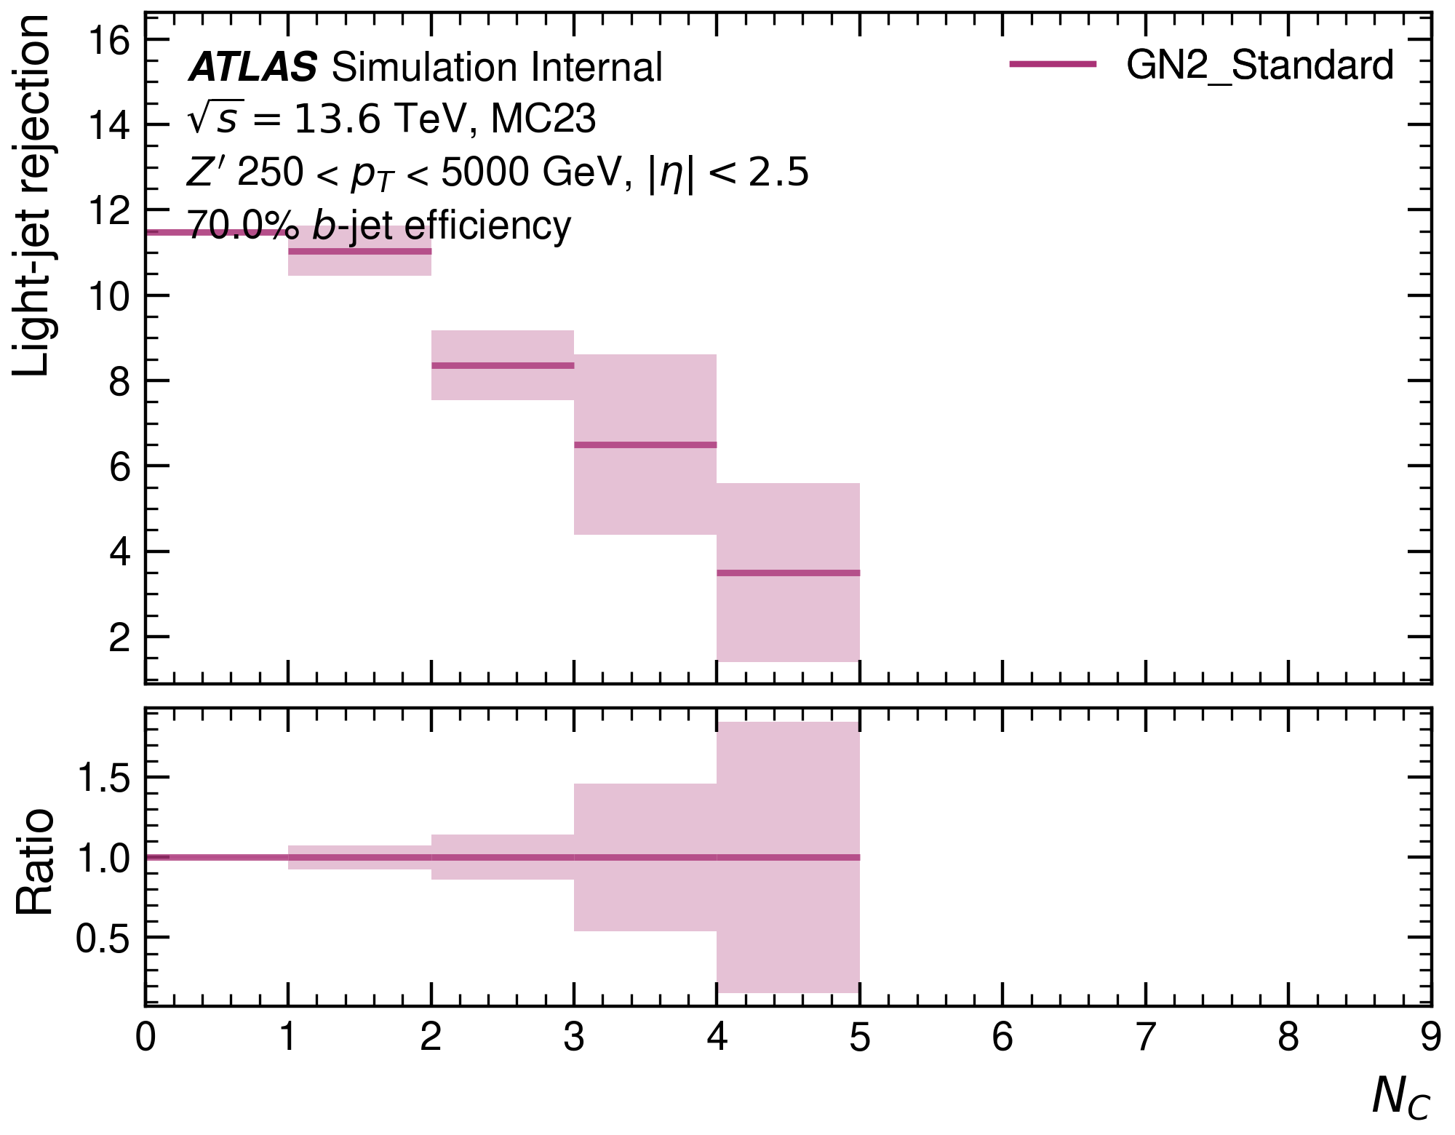

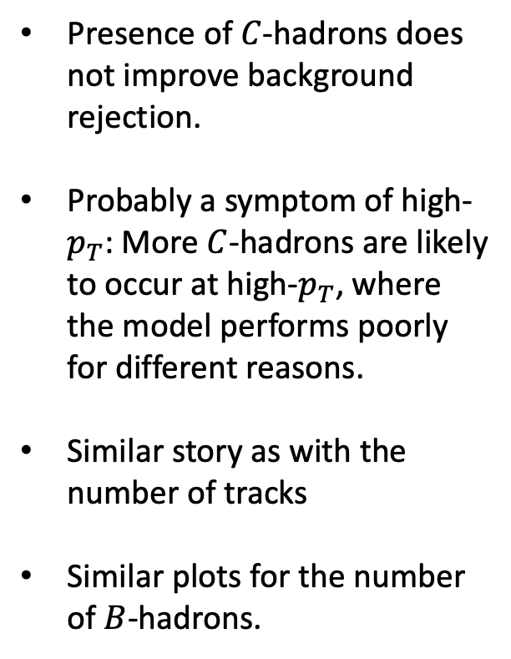
Number of $C$ hadrons: background rejection
Presence of $C$-hadrons does not improve background rejection.
Probably a symptom of high-$p_{T}$: More $C$-hadrons are likely to occur at high-$p_{T}$, where the model performs poorly for different reasons.
Similar story as with the number of tracks
Similar plots for the number of $B$-hadrons.

Slide 11
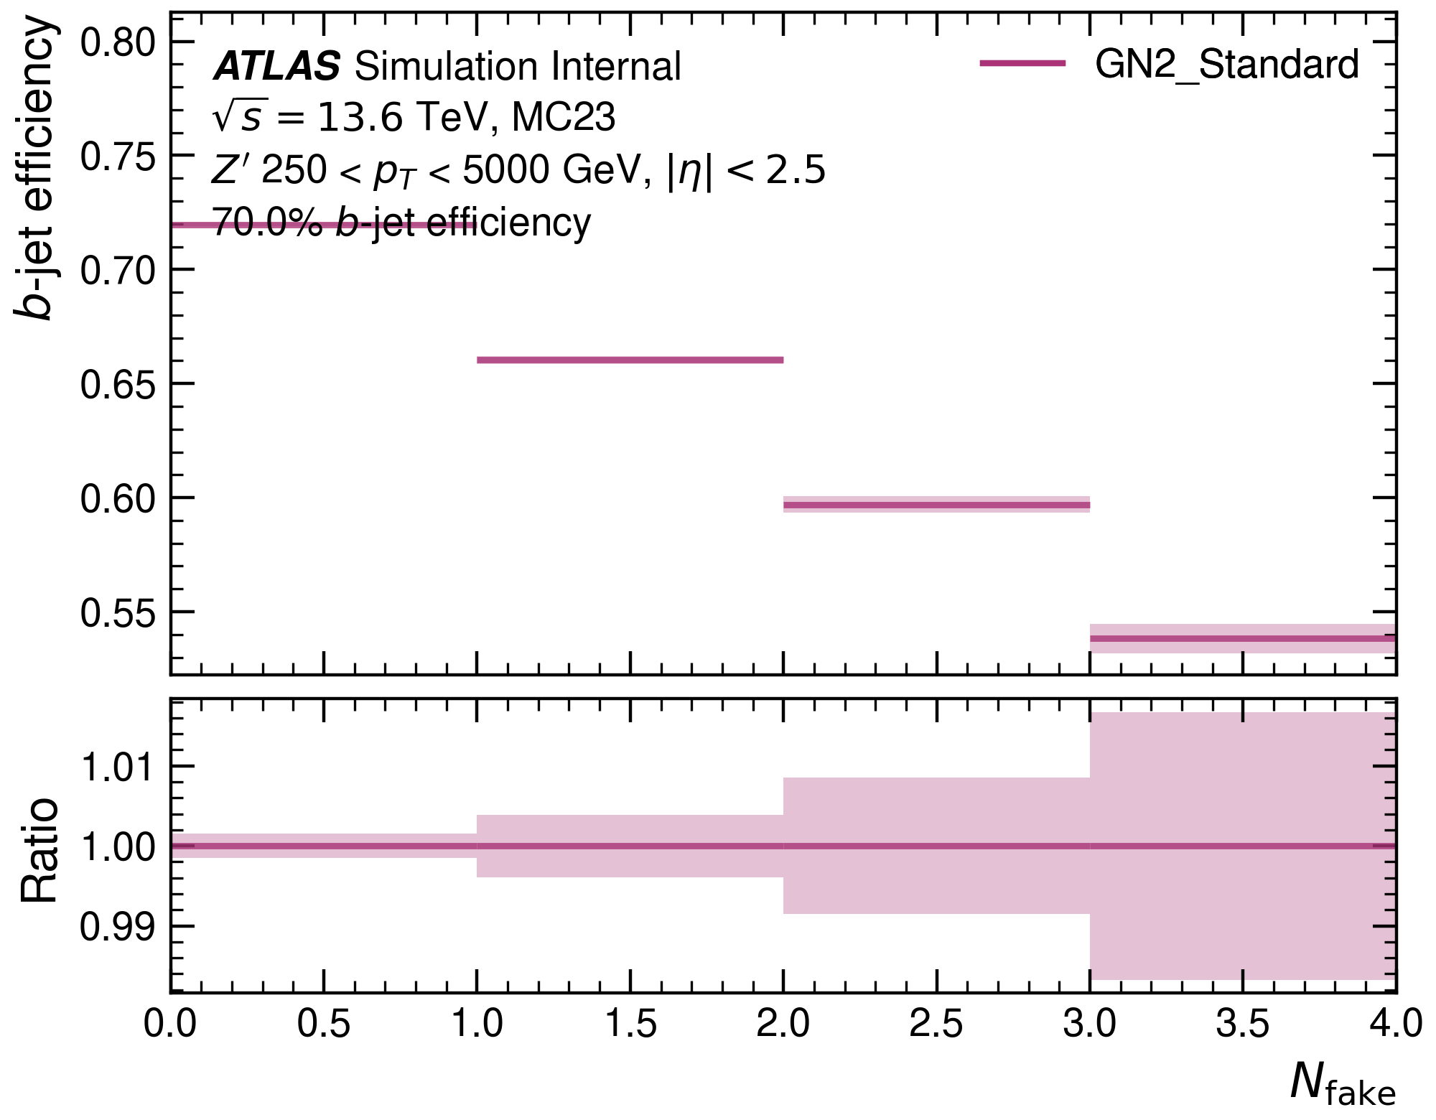
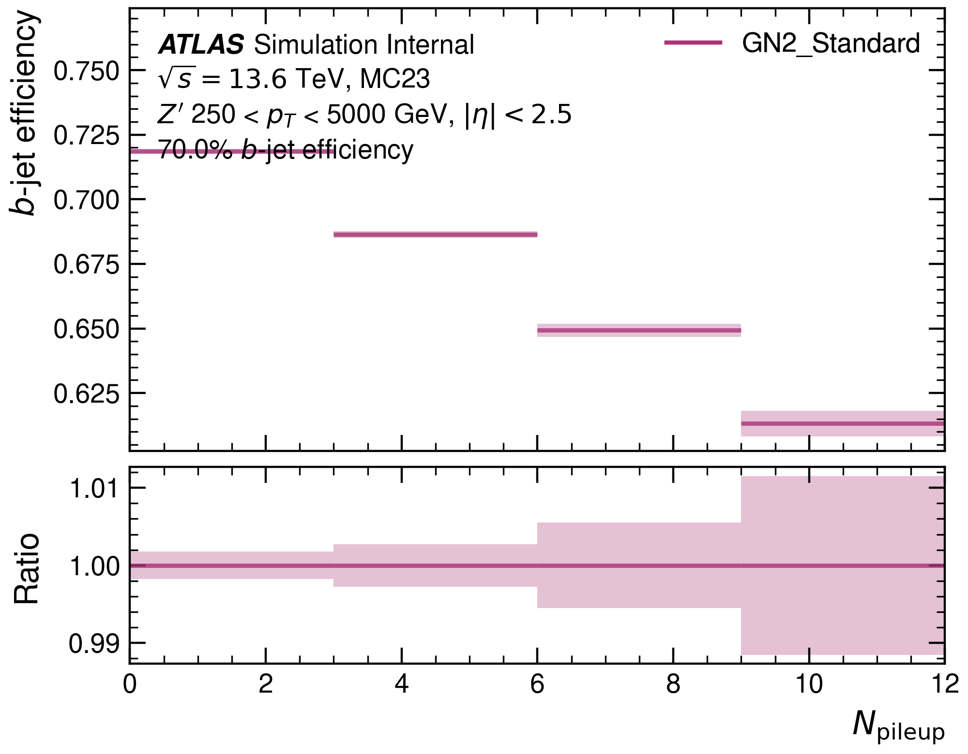
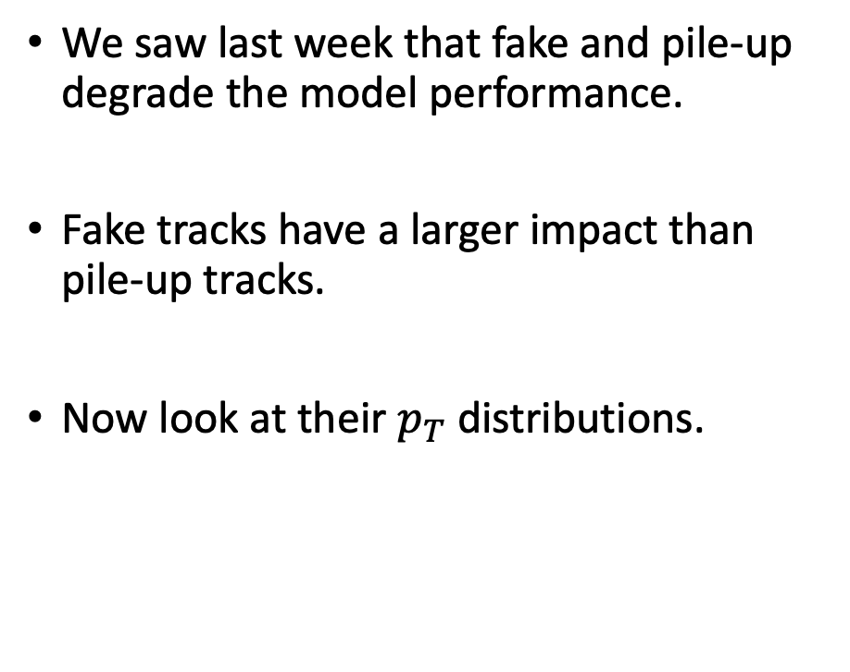
Number of fake & pile-up tracks
We saw last week that fake and pile-up degrade the model performance.
Fake tracks have a larger impact than pile-up tracks.
Now look at their $p_{T}$ distributions.

Slide 12
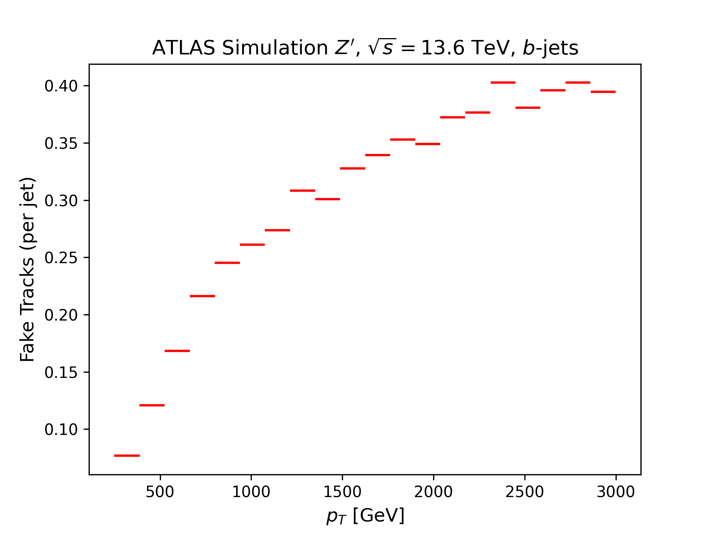
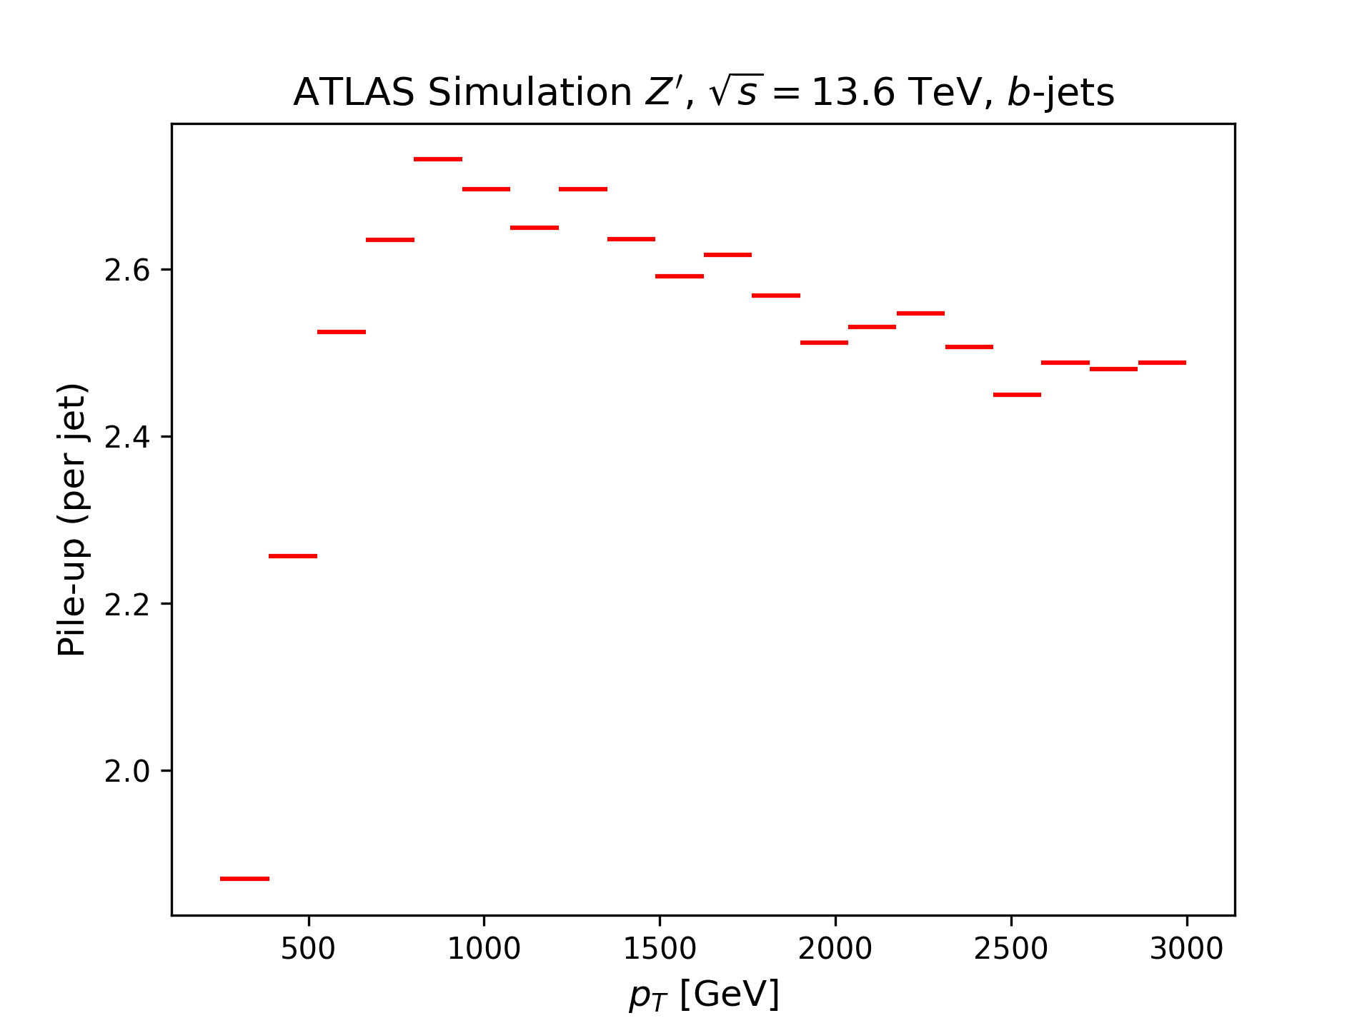
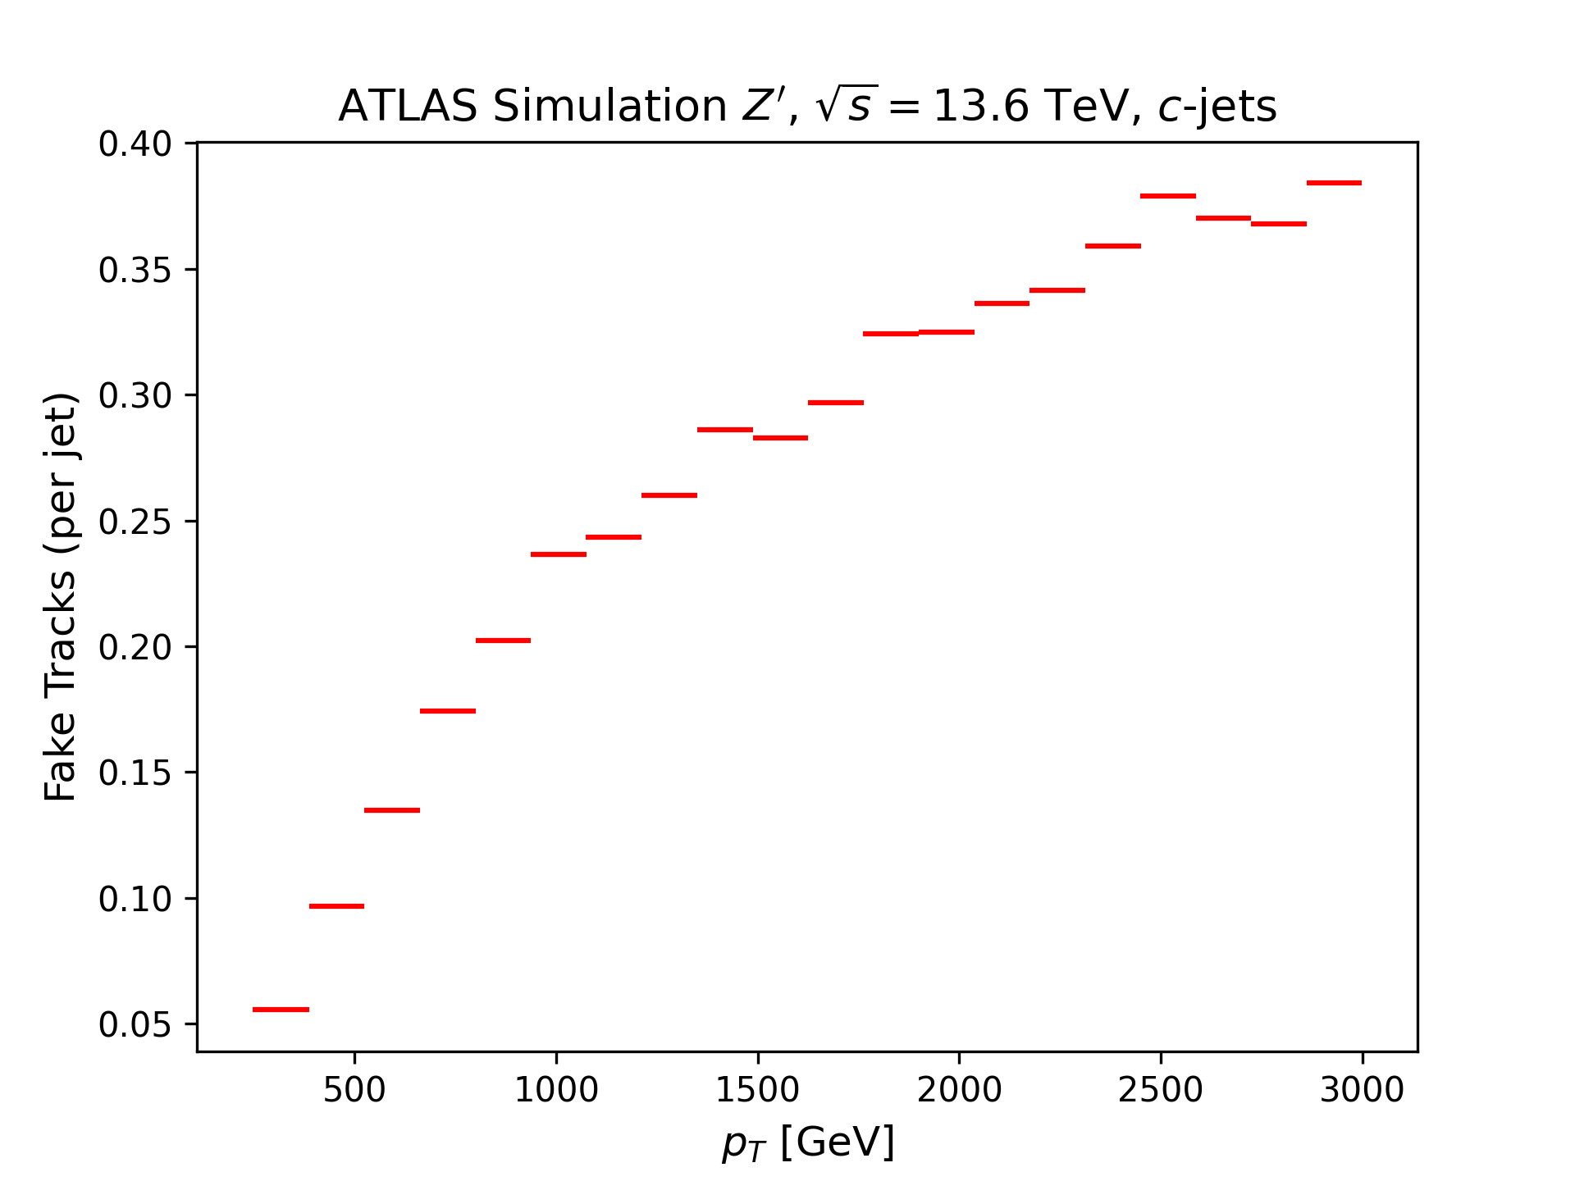
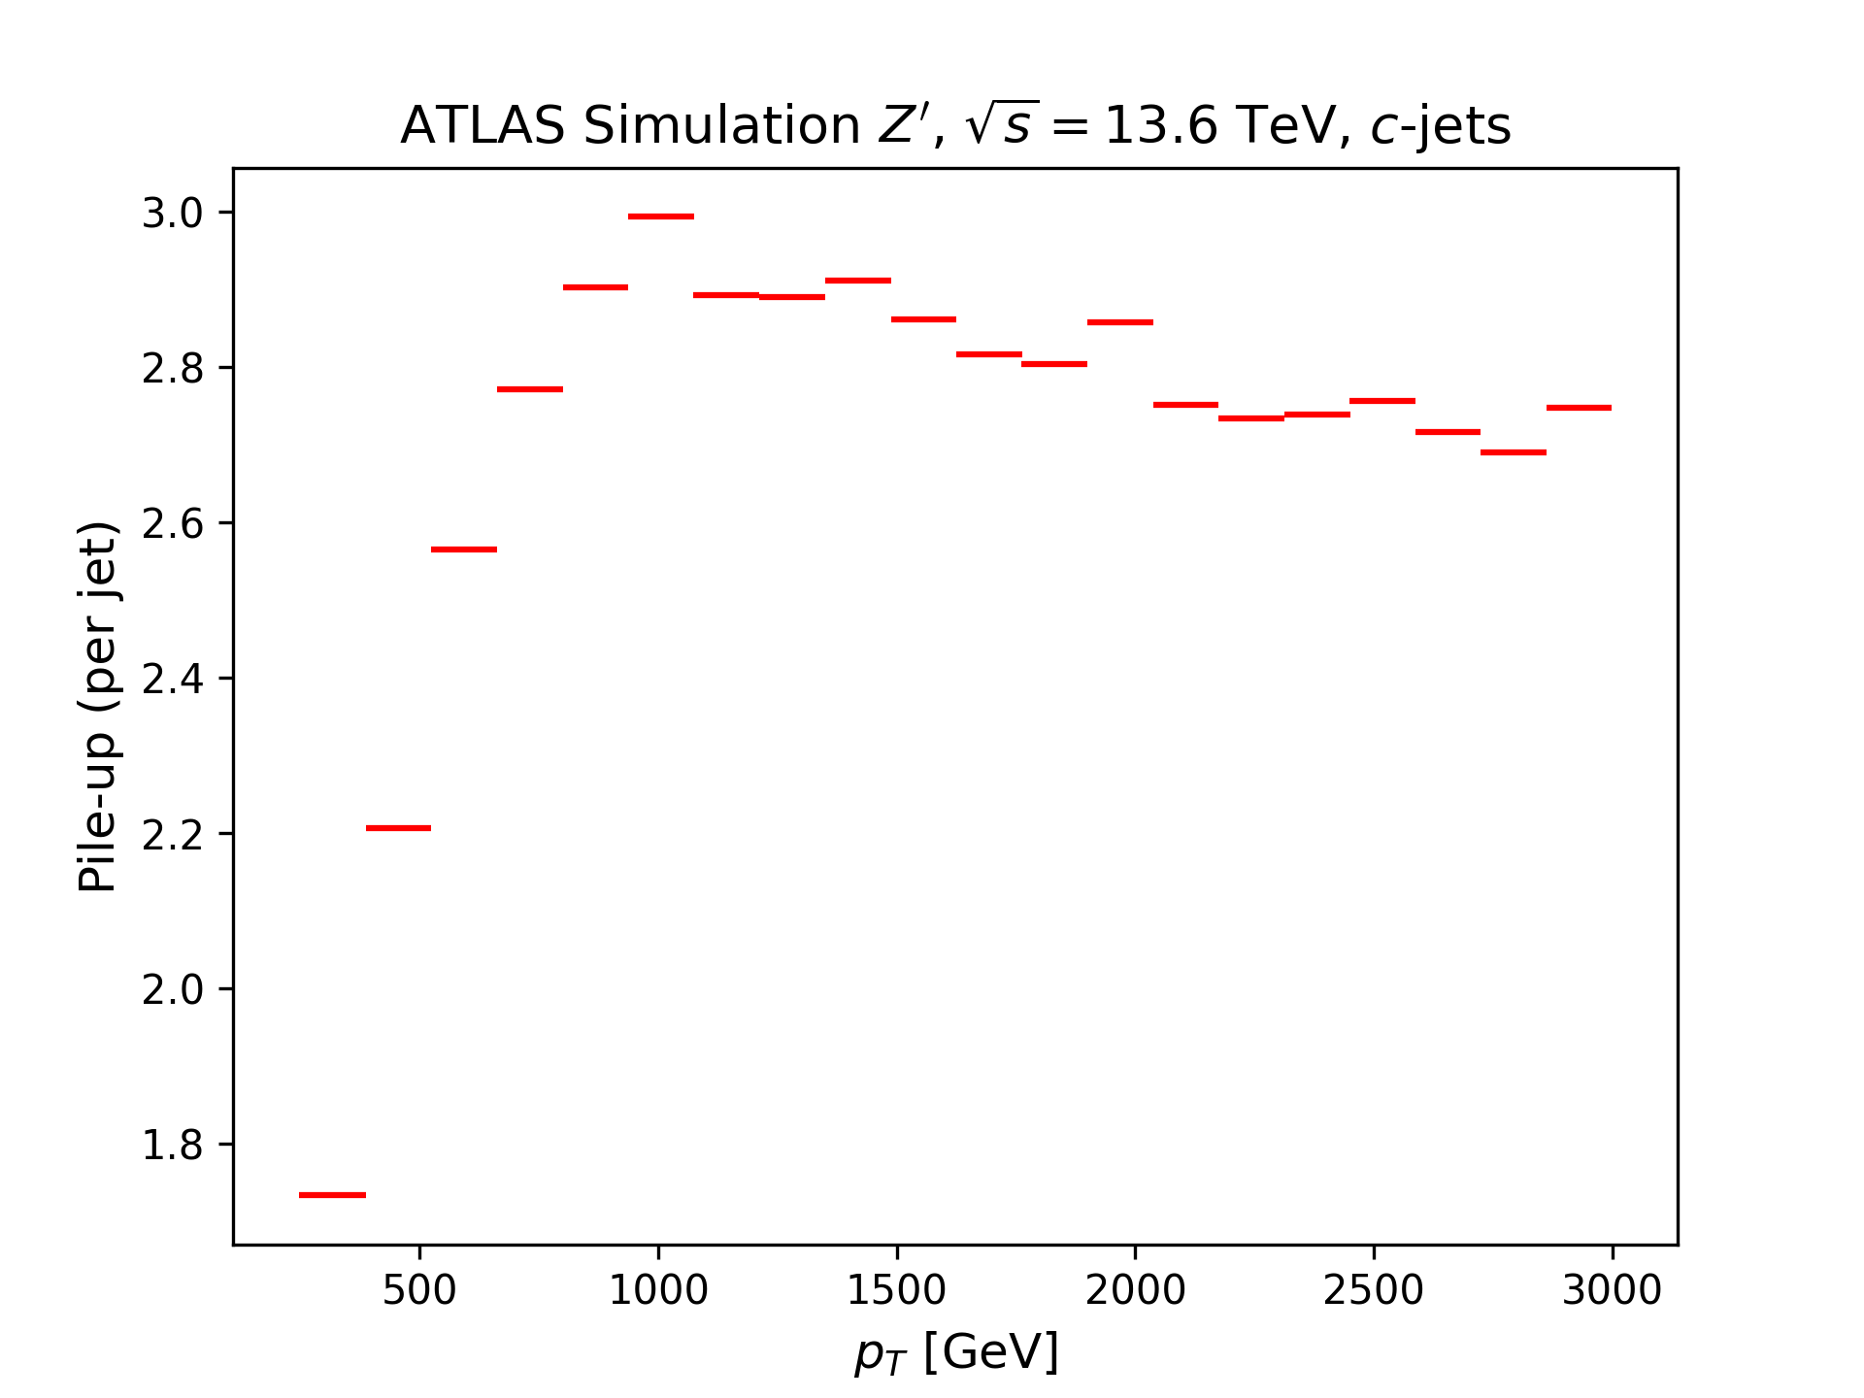
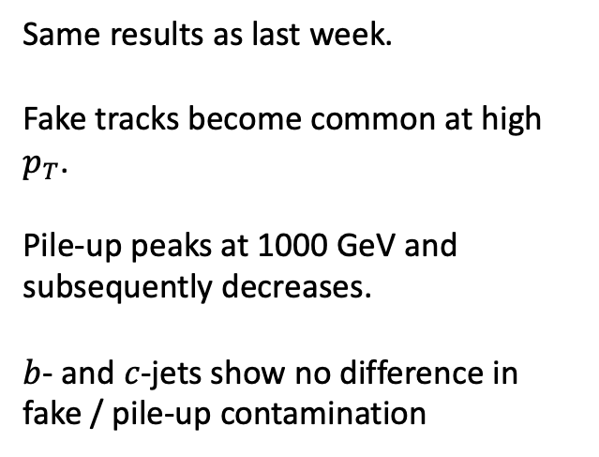

Number of fake & pile-up tracks: $p_{T}$ ($b$- and $c$-sample)
Same results as last week.
Fake tracks become common at high $p_{T}$.
Pile-up peaks at 1000 GeV and subsequently decreases.
$b$- and $c$-jets show no difference in fake / pile-up contamination

Slide 13

$p_{T}$-Distribution of other Jet Variables

Slide 14
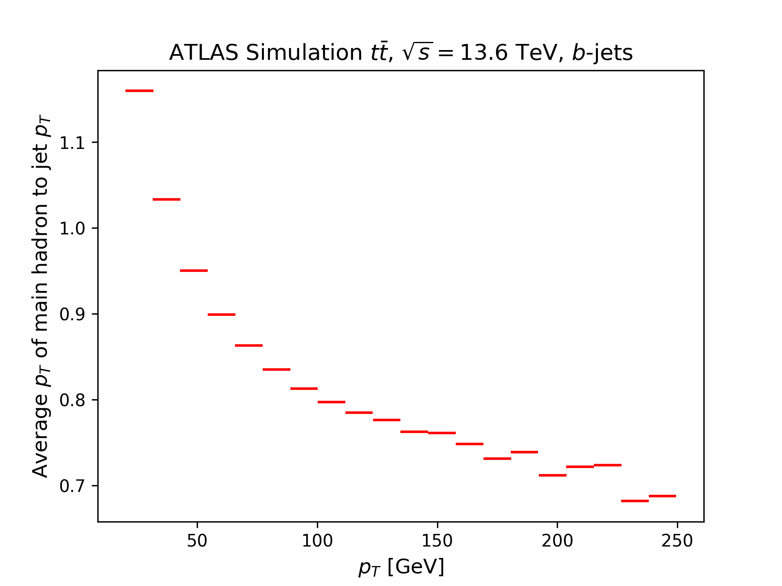
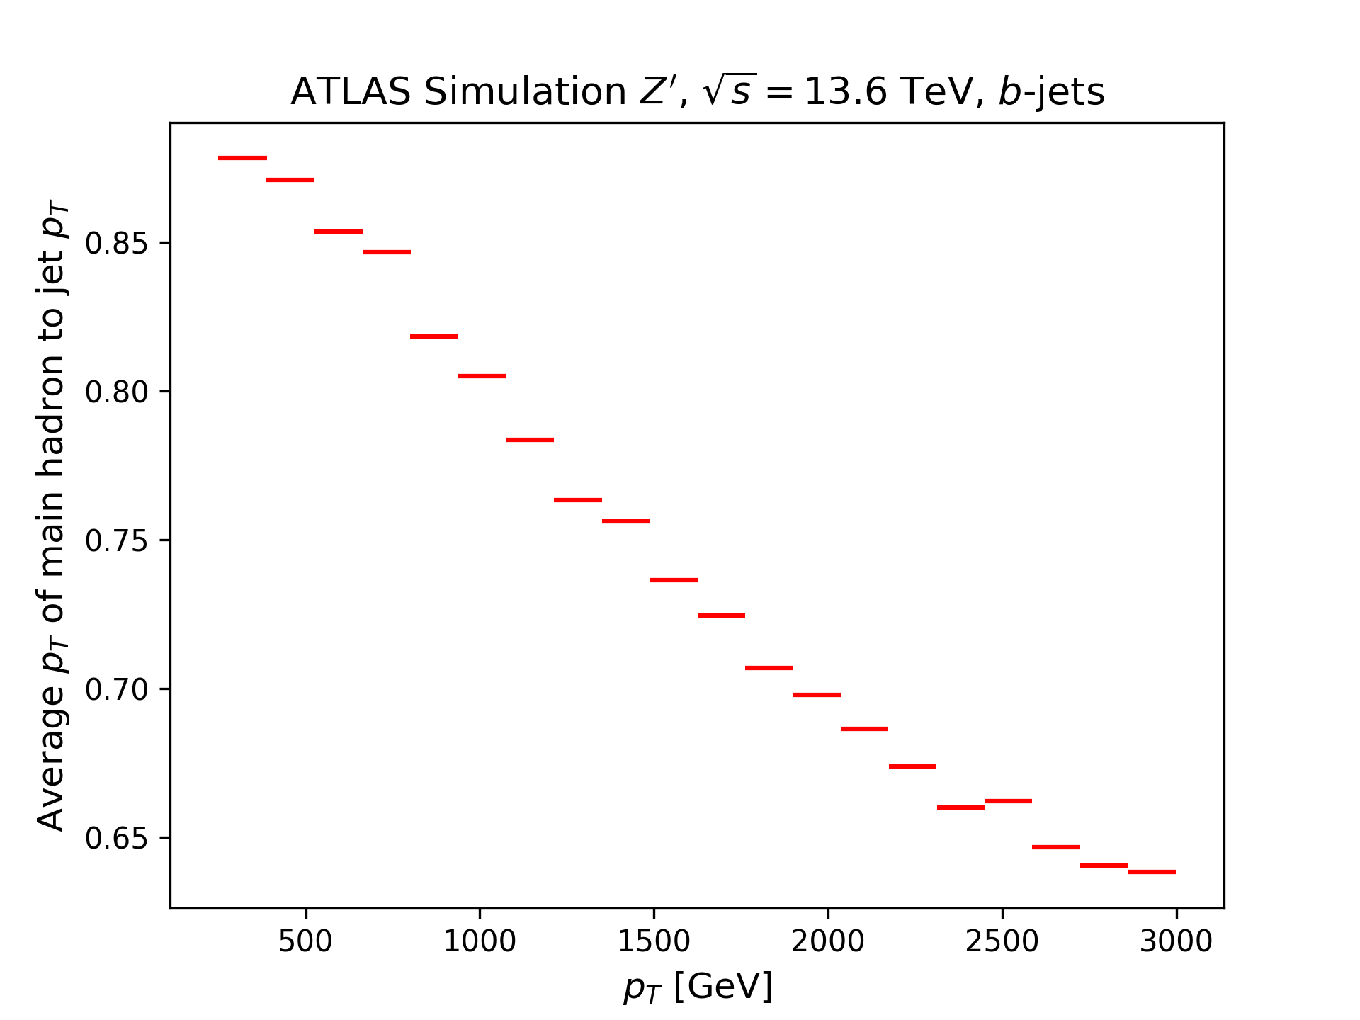

$p_{T}$ of $B$-hadron to jet $p_{T}$ ($b$-sample)
At high $p_{T}$ the main hadron ($B$-hadron) carries a smaller fraction of the total jet $p_{T}$, so there are other interactions, not derived from the main hadron.
Why can the main hadron carry more $p_{T}$ than the overall jet?

Slide 15
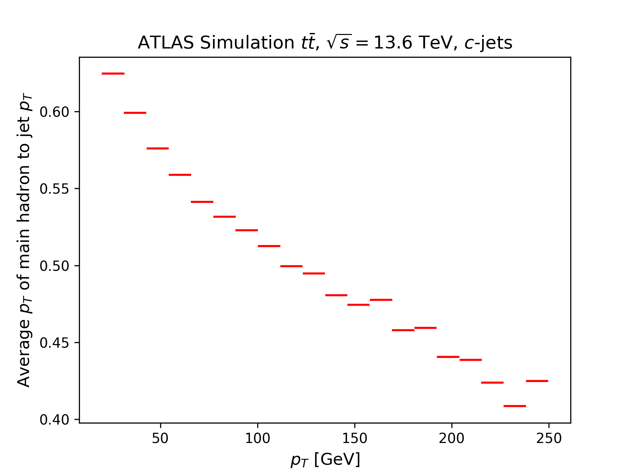
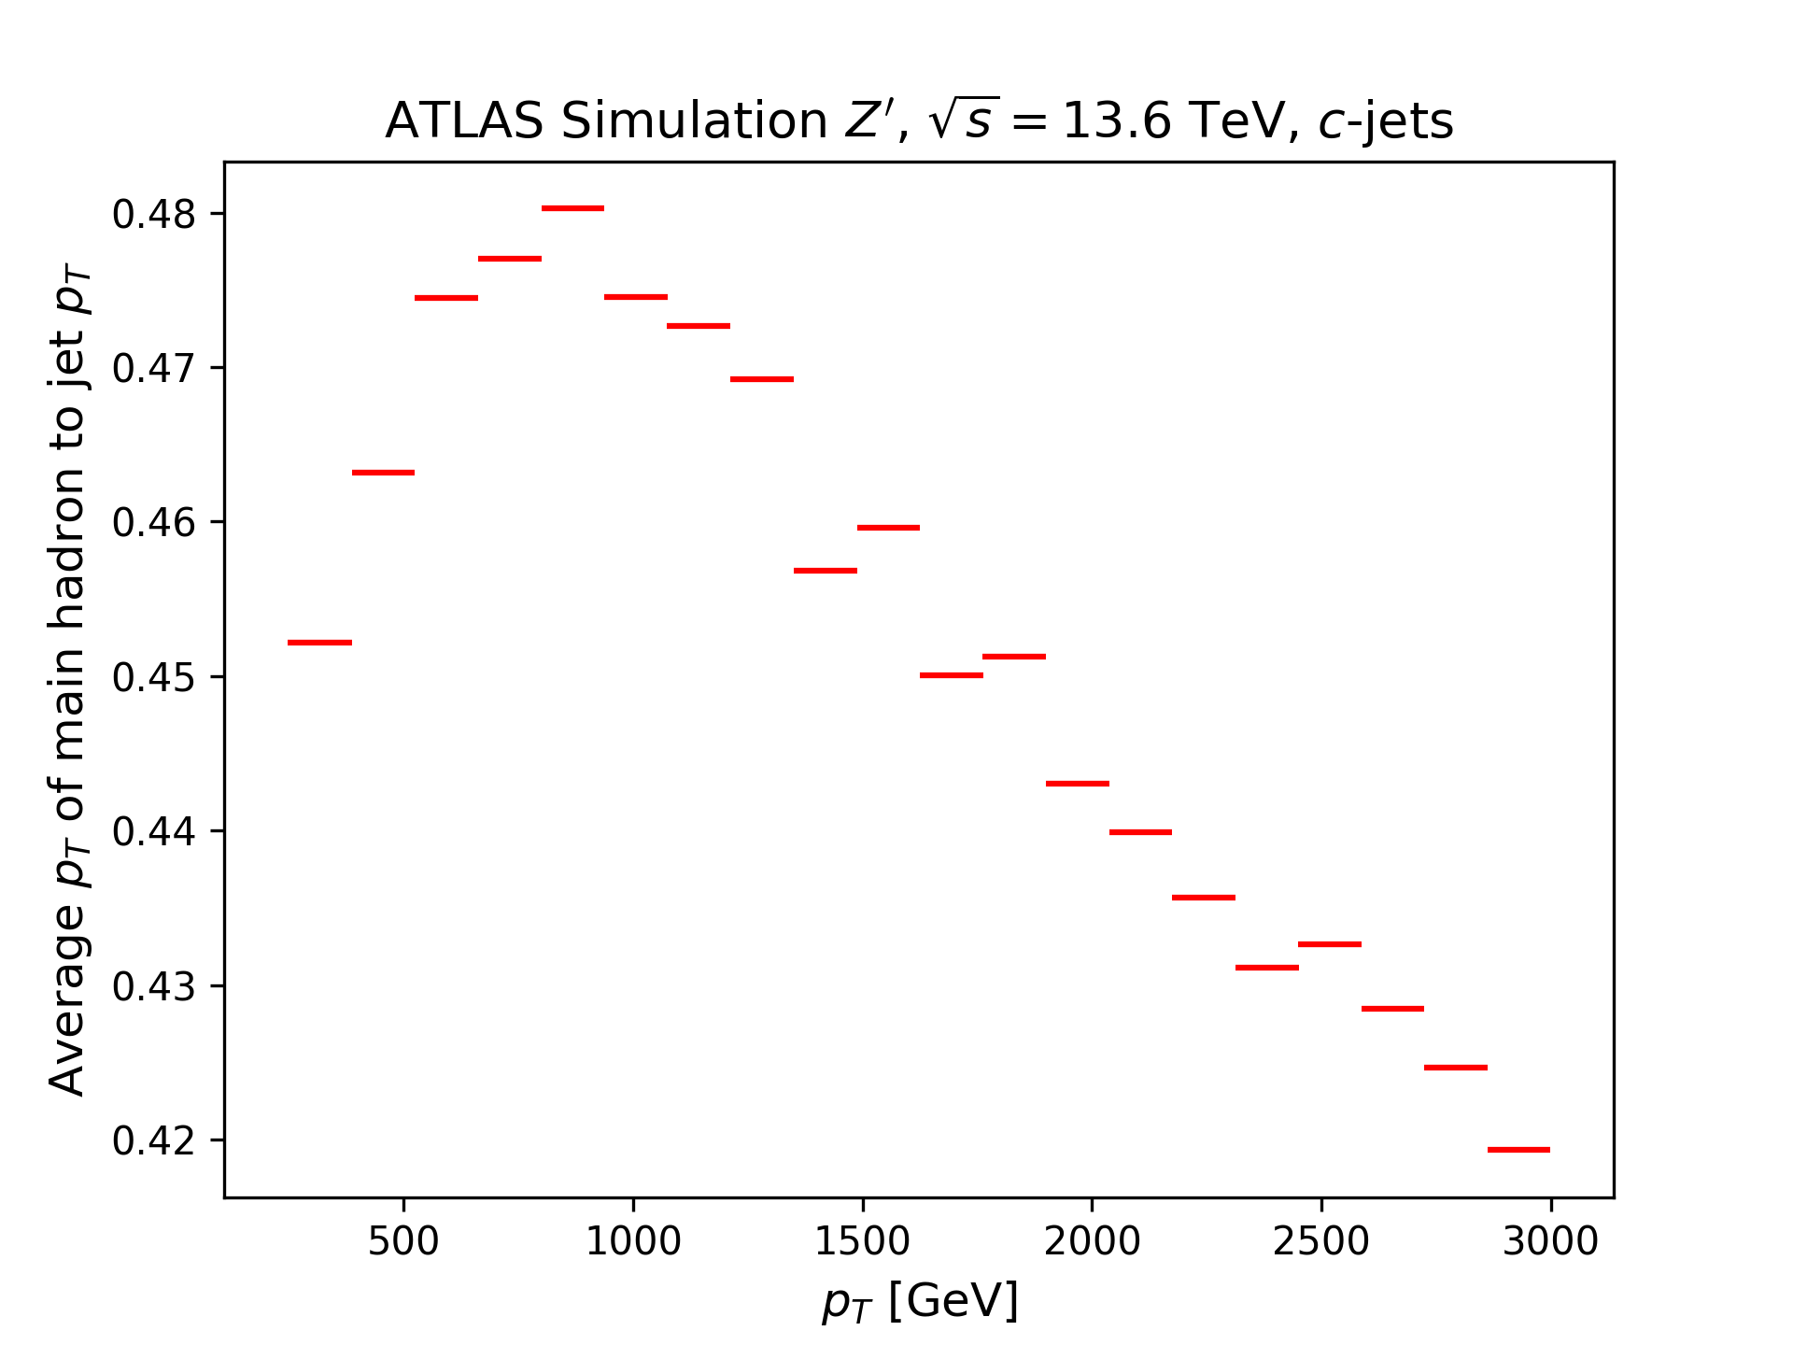

$p_{T}$ of $C$-hadron to jet $p_{T}$ ($c$-sample)
$C$-hadron overall carries less jet $p_{T}$ in $c$-jets than the $B$-hadron in $b$-jets.
Strange peak at approximately 750 GeV
Overall decreasing

Slide 16
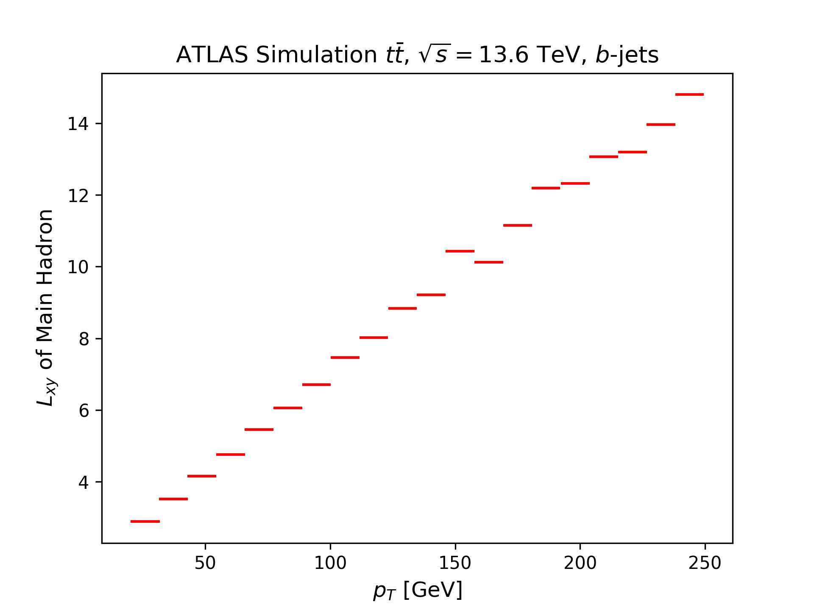
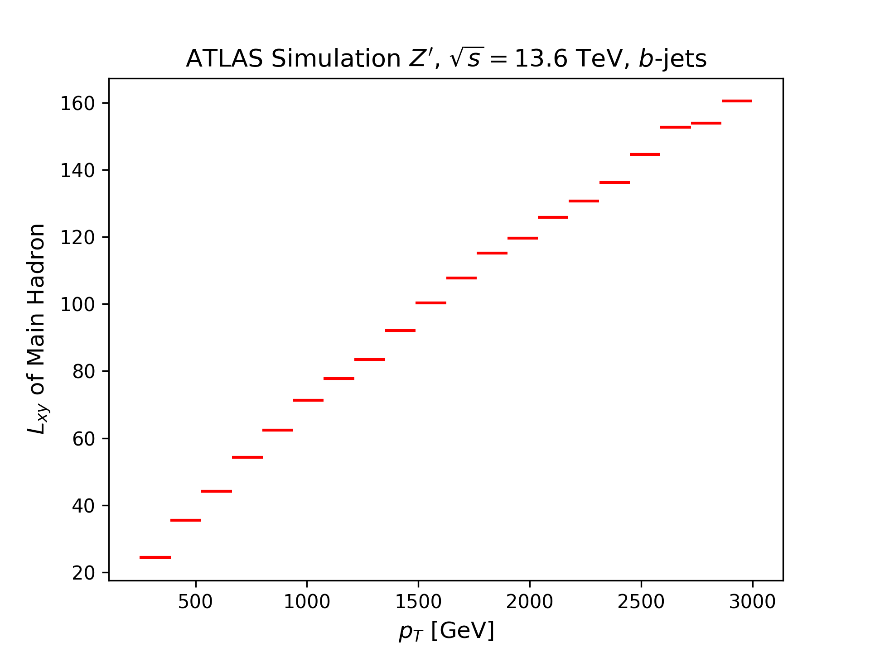
$L_{xy}$ of $B$-hadron ($b$-sample)
The decay length of the $B$-hadron in $b$-jets increases linearly with $p_{T}$.
What are the units of $L_{xy}$?

Slide 17
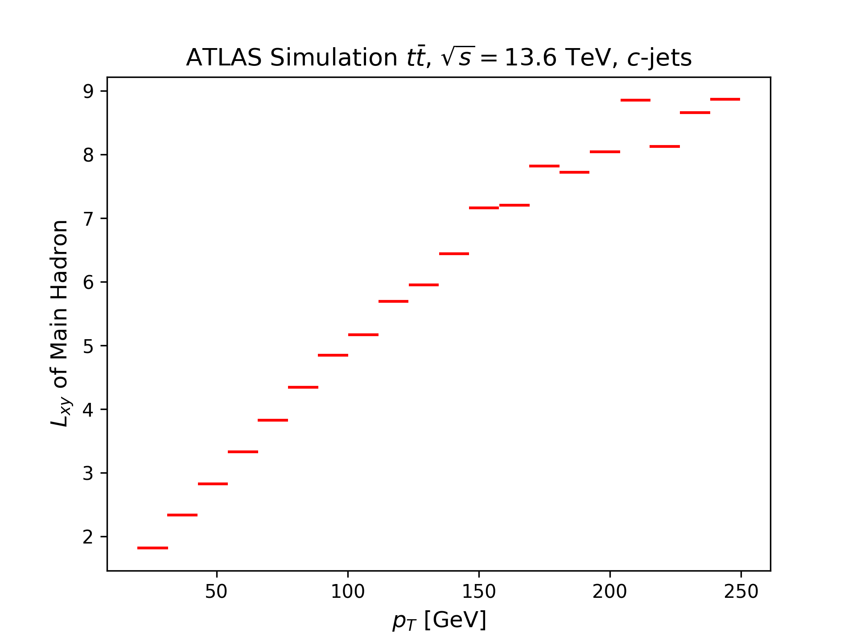
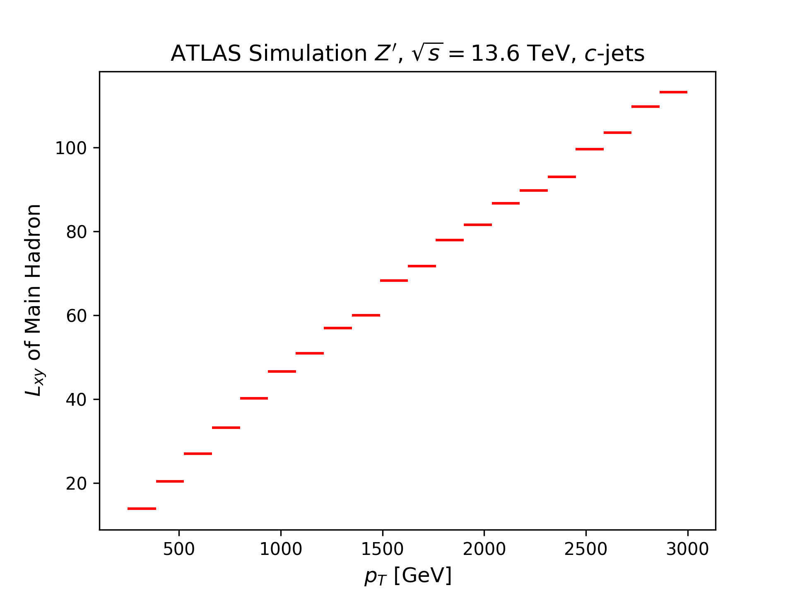
$L_{xy}$ of $C$-hadron ($c$-sample)
The decay length of the $C$-hadron in $c$-jets increases linearly with $p_{T}$.
Doesn’t travel as far as the $B$-hadron in the $b$-sample.

Slide 18
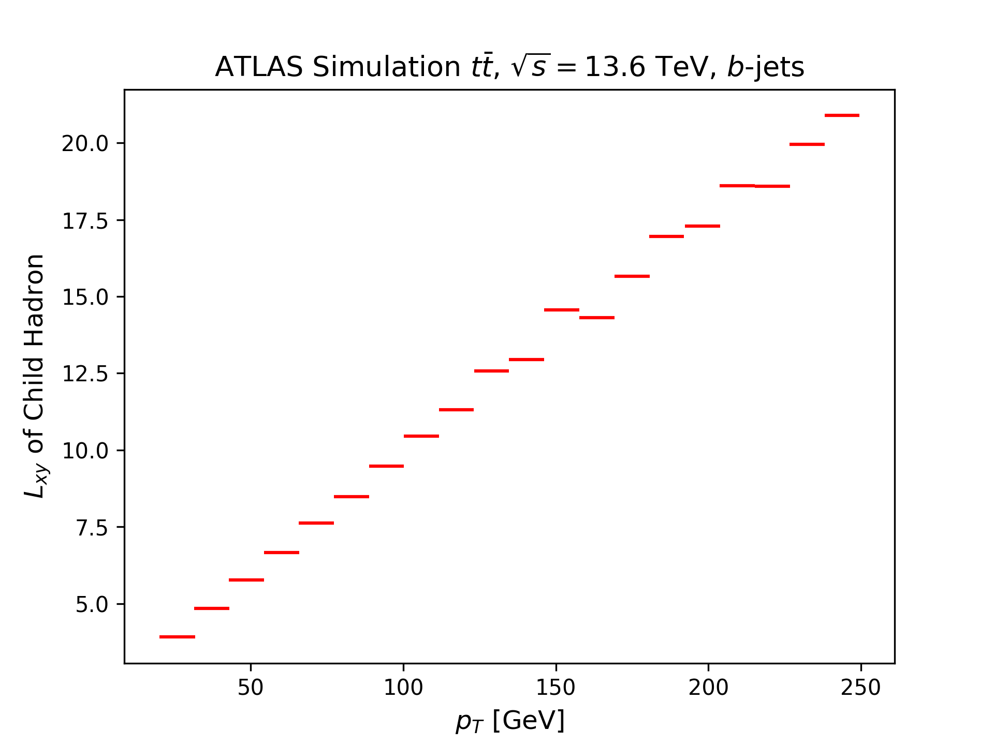

$L_{xy}$ of Child Hadron ($b$-sample)
Same $p_{T}$ dependence as main hadron.
Overall larger $L_{xy}$ values for the child hadron.

Slide 19






Number of Primary Tracks (All samples)

Slide 20



$p_{T}$ Histogram for $b$- $c$- and light-jets
Distinct $p_{T}$ distributions in $t\overline{t}$ sample. Makes it easier for the model to distinguish?
$Z′$: $b$- and $c$-jet have an almost identical distribution -> look very similar to the model, light-jets still very distinct.

Slide 21

Summary & Next Steps
$c$- and $b$-jets have similar kinematic properties, while light-jets look more distinct.
I have not been able to look at the model performance against these last variables.
Derive model improvements from these results.
Choose project direction for the rest of the year.

